Slide 1
The age and provenance of rocks: radiogenic isotopes
EART26201 | Principles of Geochemistry | Lecture 2
Part 1 | Introduction

Slide 2
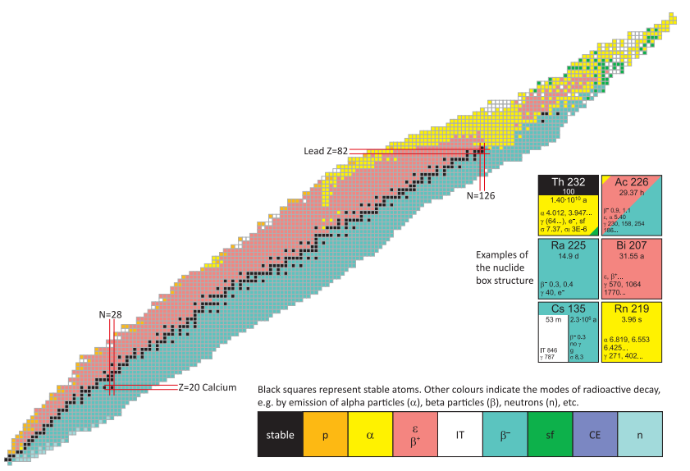
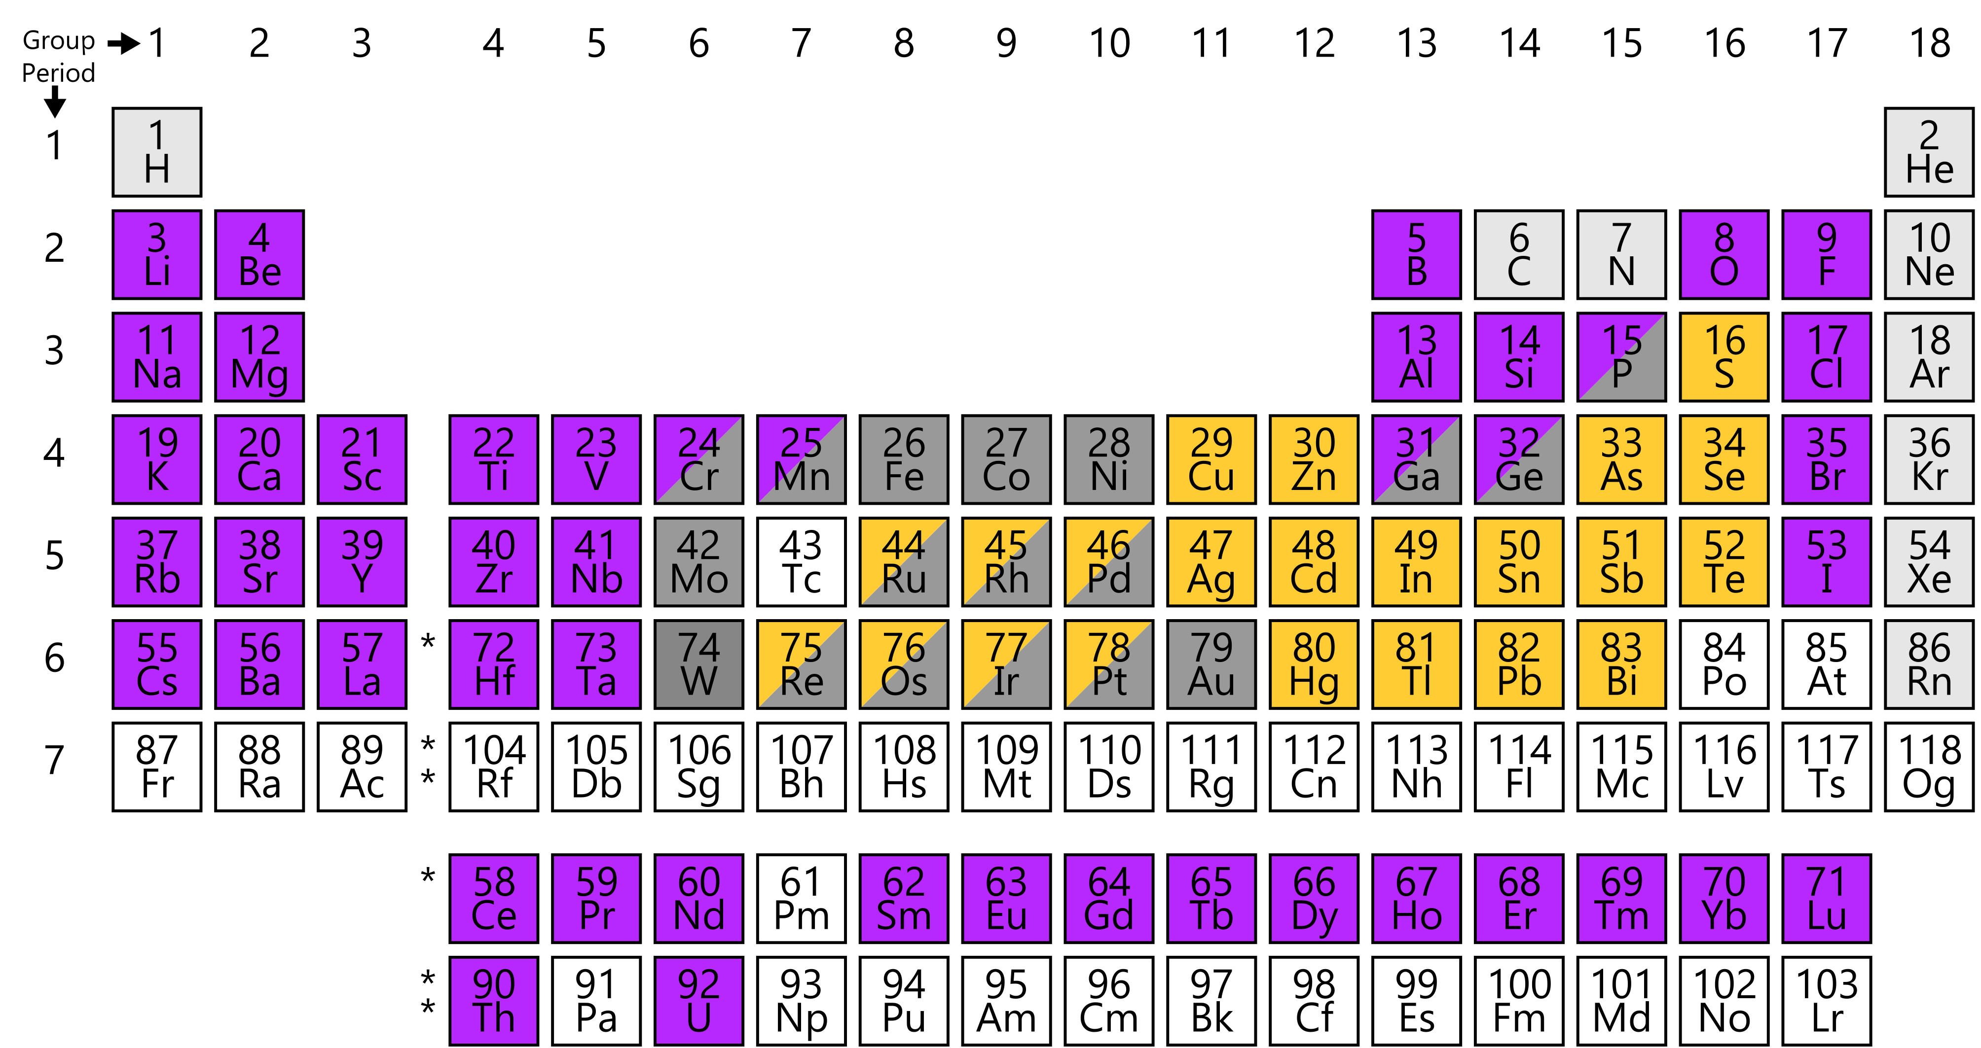
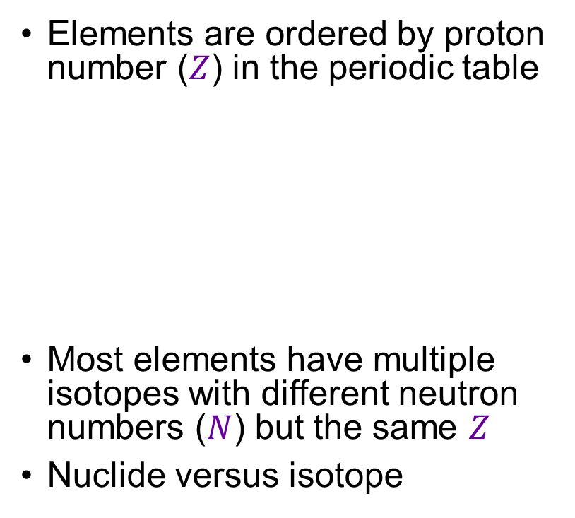


Elements and isotopes
Elements are ordered by proton number ($Z$) in the periodic table
Most elements have multiple isotopes with different neutron numbers ($N$) but the same $Z$
Nuclide versus isotope
The Karlsruhe Nuclide Chart
Protons ($Z$)
Neutrons ($N$)

Slide 3
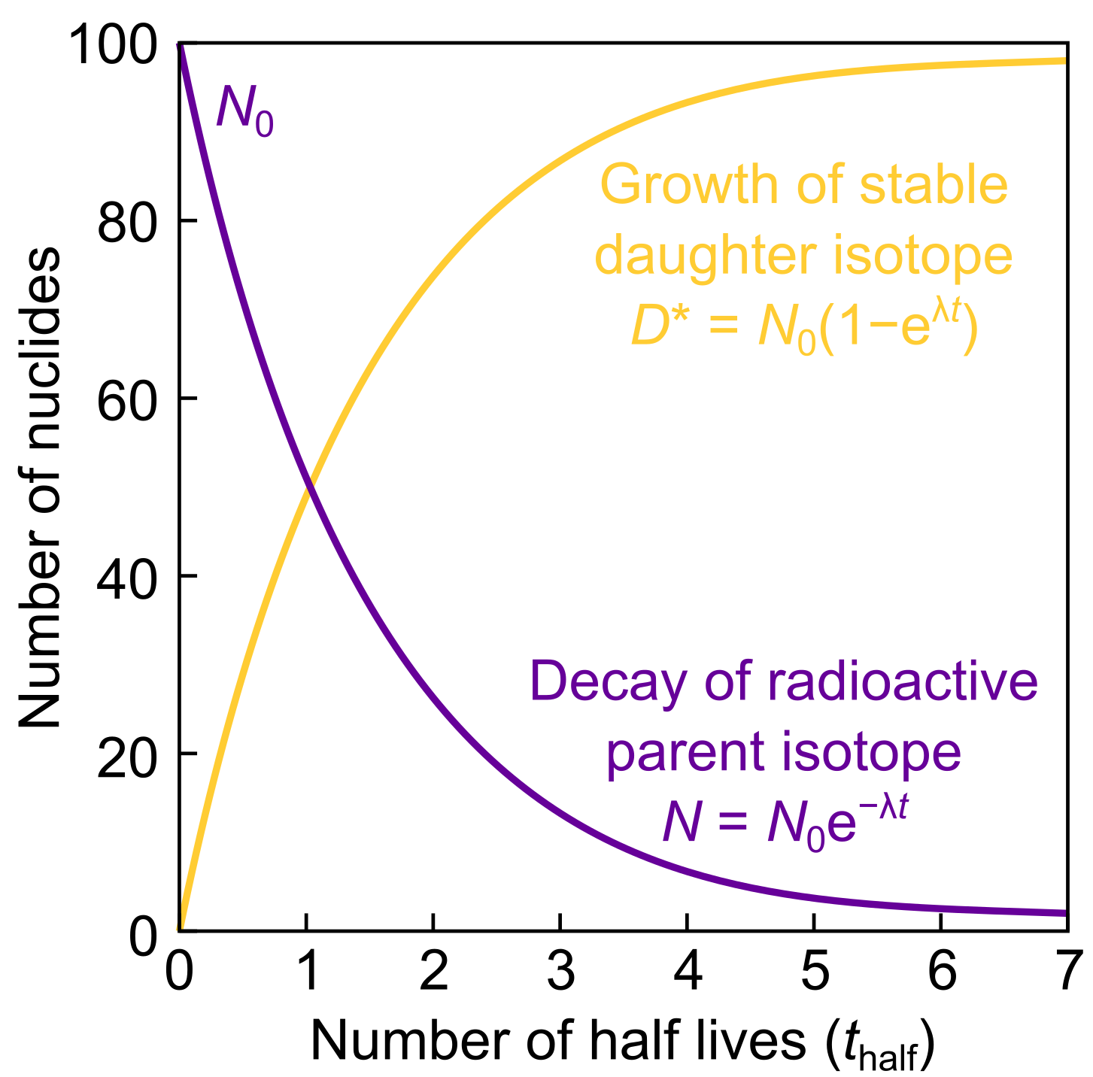
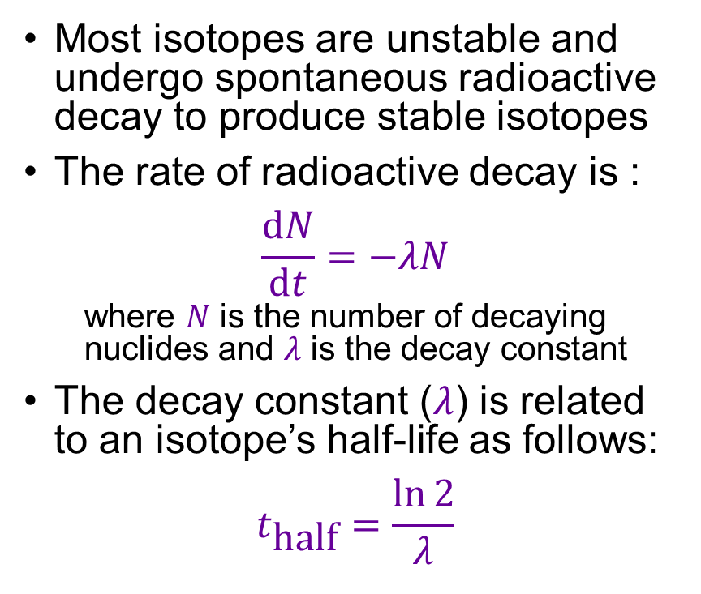
Stability and radioactive decay
Most isotopes are unstable and undergo spontaneous radioactive decay to produce stable isotopes
The rate of radioactive decay is :
$$\frac{dN}{dt}=−λN$$
  where $N$ is the number of decaying nuclides and $λ$ is the decay constant
The decay constant ($λ$) is related to an isotope’s half-life as follows:
$$t_{\text{half}}=\frac{\ln{2}}{λ}$$

Slide 4
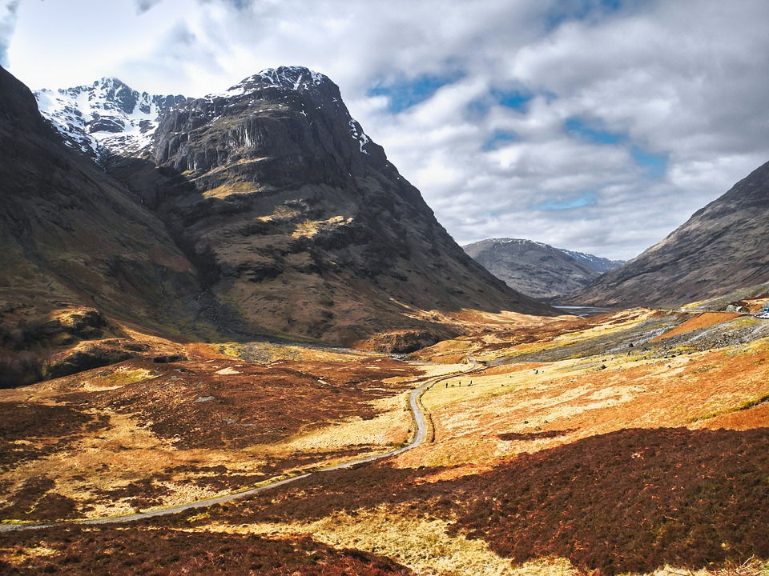
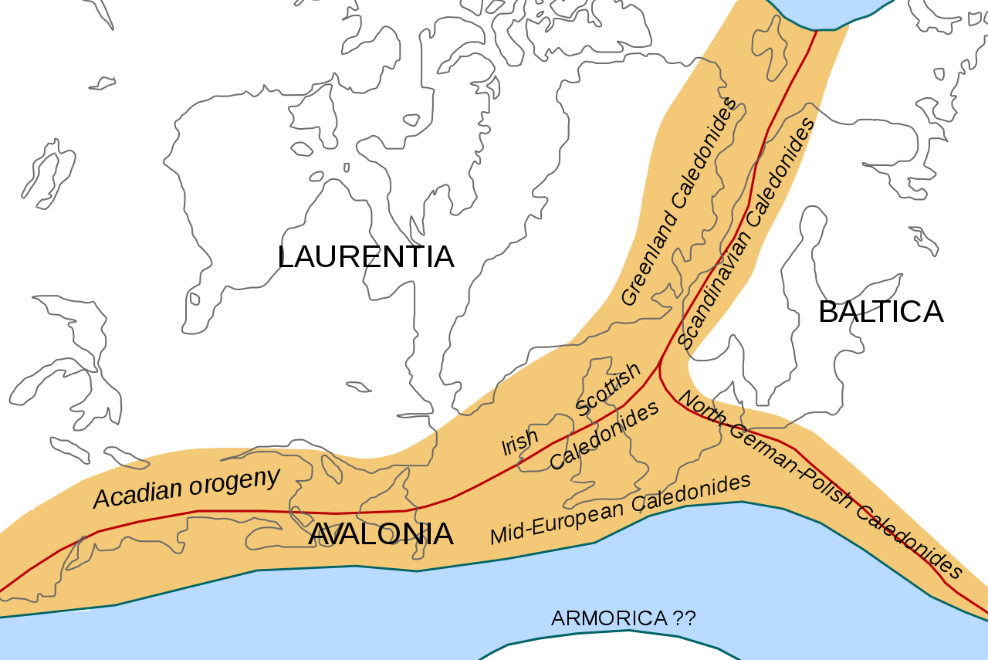
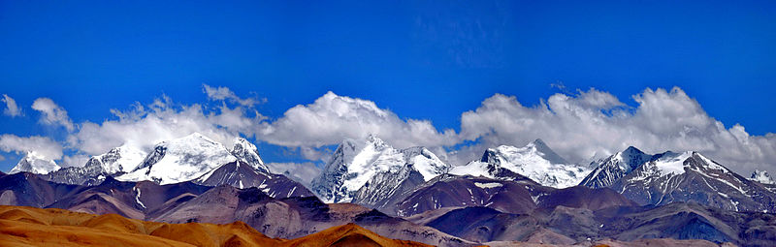


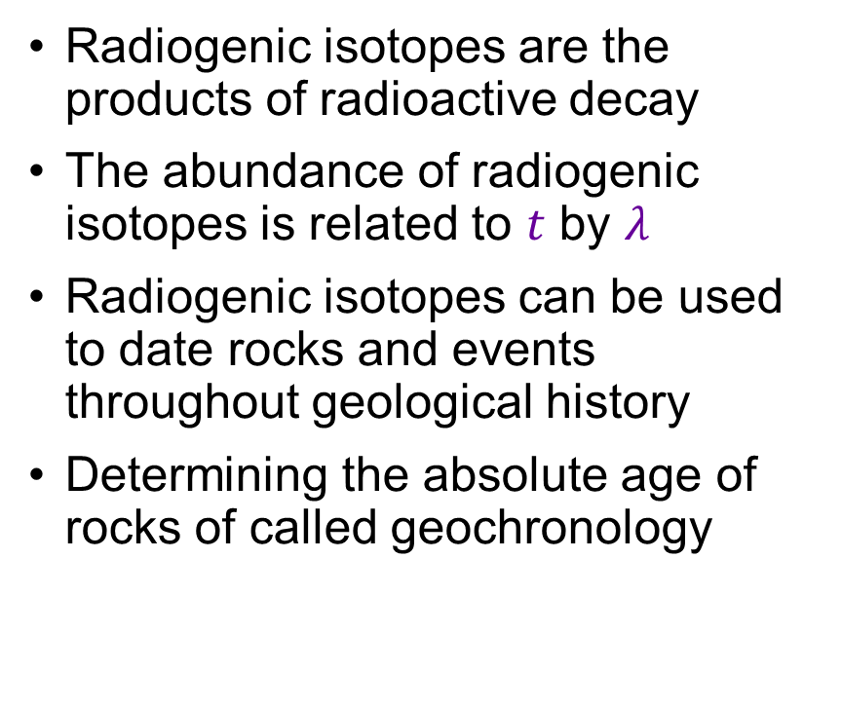
The power of radiogenic isotopes: rock ages
Radiogenic isotopes are the products of radioactive decay
The abundance of radiogenic isotopes is related to $t$ by $λ$
Radiogenic isotopes can be used to date rocks and events throughout geological history
Determining the absolute age of rocks of called geochronology
Caledonian Orogeny
Scottish Highlands
400–425 Ma
Matte (2001)
credit: MaxPixel
Himalaya
credit: Michel Royon

Slide 5
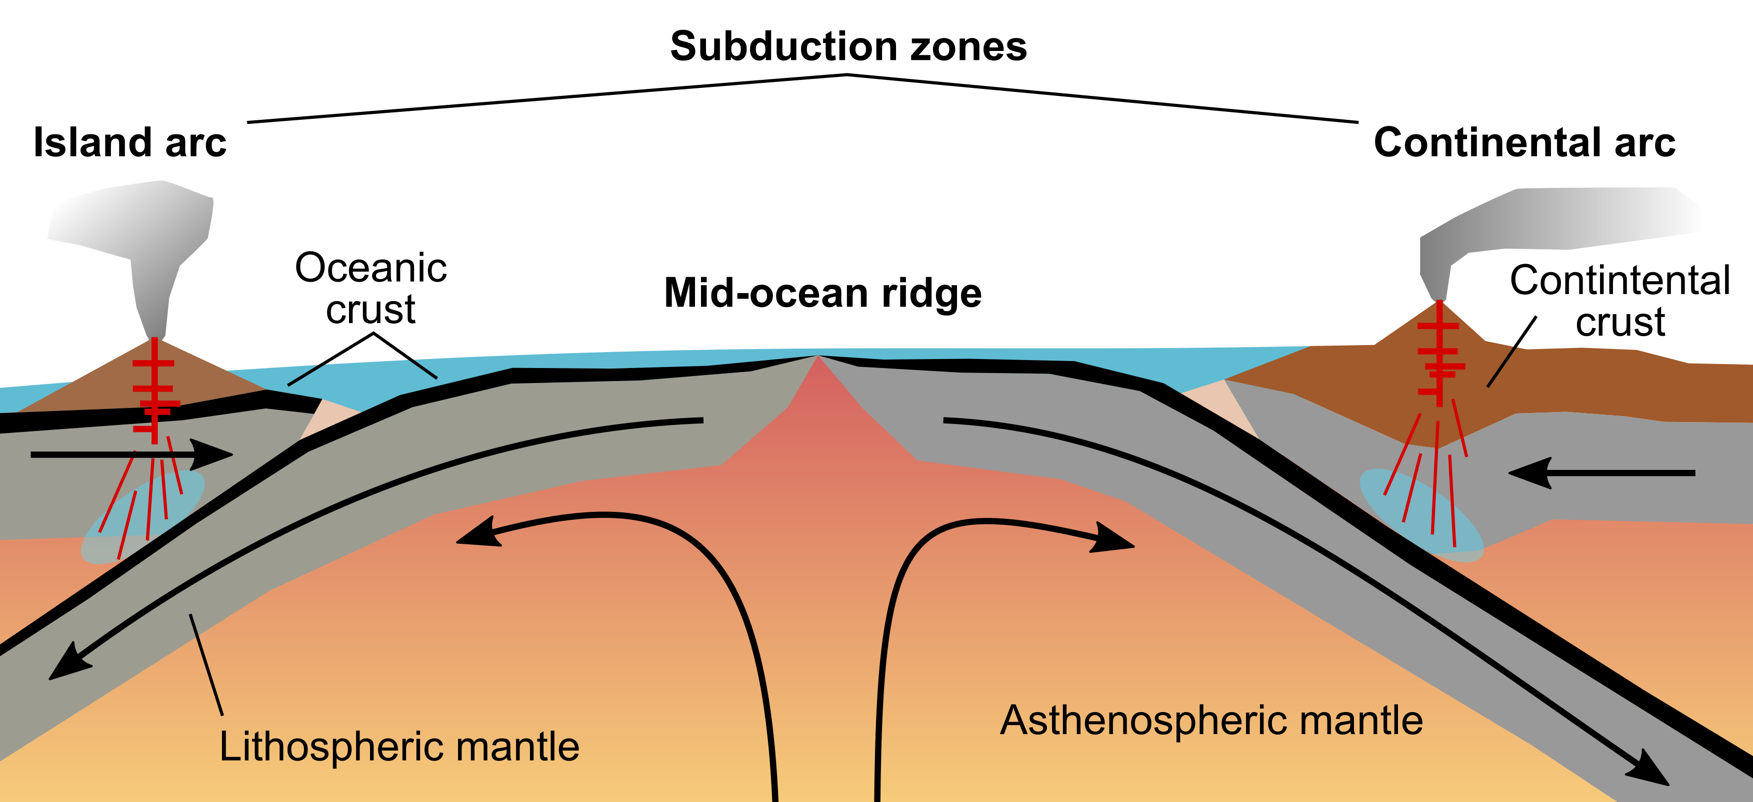
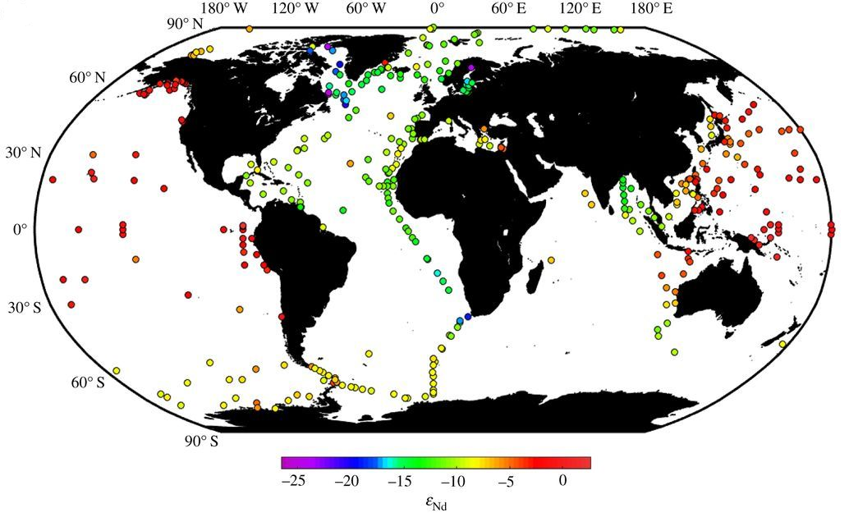
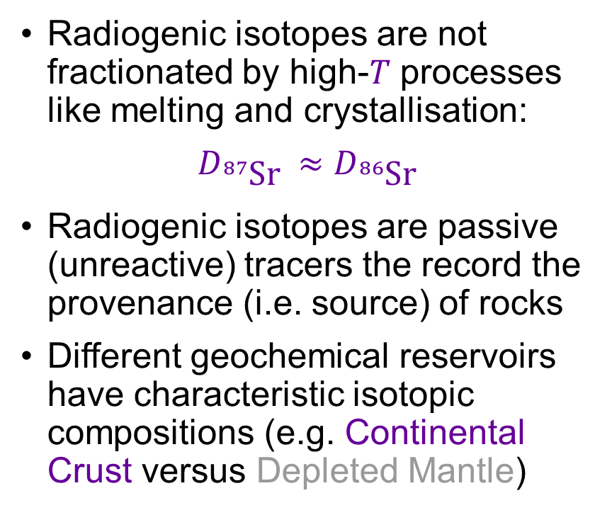
The power of radiogenic isotopes: rock provenance
Radiogenic isotopes are not fractionated by high-$T$ processes like melting and crystallisation:
$$D_{{}_{}^{87}{\text{Sr}} }≈D_{{}_{}^{86}{\text{Sr}} }$$
Radiogenic isotopes are passive (unreactive) tracers the record the provenance (i.e. source) of rocks
Different geochemical reservoirs have characteristic isotopic compositions (e.g. Continental Crust versus Depleted Mantle)
Determine fluxes
between Earth’s
geochemical
reservoirs
Track ocean
currents with
Nd isotopes
van der Fierdt et al. (2016)

Slide 6
Lecture 2 synopsis
Synchronous
Part 1 | Introduction
Part 2 | Radioactive decay
Part 3 | Dating and isochron diagrams
Part 4 | Isotopic evolution of the crust and mantle
Part 5 | Provenance and the mantle array
Further reading | Misra, Chapter 10 (theoretical overview)
Further reading | White, Chapter 8 (detailed and comprehensive)

Slide 7
The age and provenance of rocks: radiogenic isotopes
EART26201 | Principles of Geochemistry | Lecture 2
Part 2 | Radioactive decay

Slide 8
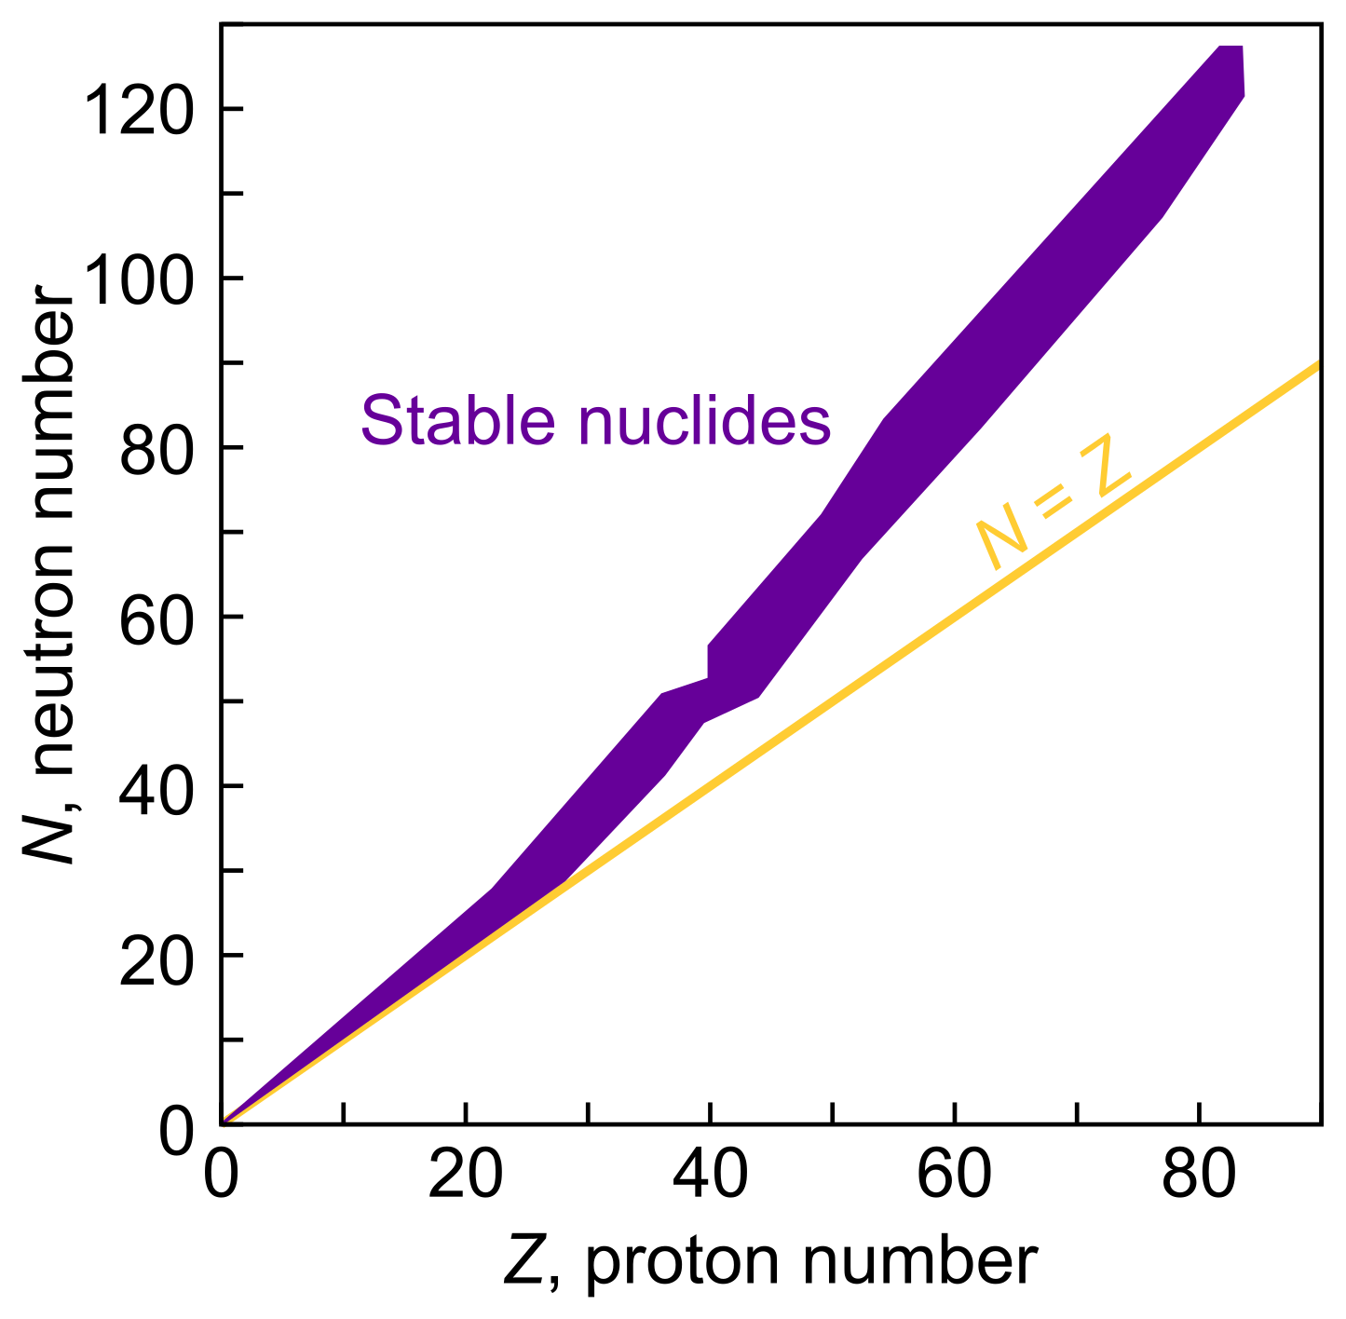
Nuclear structure and stability
Nuclei contain protons (+ charge) and neutrons (no charge)
The atomic mass ($A$) is the sum of the proton number ($Z$) and the neutron number ($N$)
In stable nuclei, $Z≈N$, though
$N>Z$ in heavier nuclides
Nuclides where $Z$ and/or $N$ are even numbers are more stable
Stability is greatest when $Z$ or $N$ is 2, 8, 20, 28, 50, 82 or 126
Oddo-Harkins rule in Lecture 1

Slide 9
Radioactive decay
Unstable parent nuclides undergo radioactive decay to different but not always stable daughter nuclides
Unstable nuclides can exist for between 10⁻¹⁴ s and 10¹¹ years
The rate of decay depends on the energy state of the nuclide alone, and is described by:
$$\frac{dN}{dt}=−λN$$
  where $N$ is the number of decaying nuclides and $λ$ is the decay constant

Slide 10
Mechanisms of radioactive decay
Alpha decay
When an α-particle with 2 protons and 2 neutrons (i.e. a He nucleus) escapes the nucleus, reducing both $Z$ and $N$
Beta decay
When a β-particle (either a positron or an electron) escapes the nucleus changing the ratio of $Z$ to $N$
Gamma decay
The decay of an excited nucleus to a more stable state by the release of a
γ-ray; neither $Z$ nor $N$ change
Gamma
decay
Beta
decay
Alpha decay

Slide 11
Decay constants and half-lives
The rate of decay is described by:
$$\frac{dN}{dt}=−λN$$
  where $N$ is the number of decaying nuclides and $λ$ is the decay constant
With respect to initial number of decaying nuclides ($N_{0}$) at $t=0$:
$\ln{\frac{N}{N_{0}}}=−λt$ or $N=N_{0}e^{−λt}$
Half-life (time to reduce $N$ by half) is given as follows:
$$t_{\text{half}}=\frac{\ln{2}}{λ}$$

Slide 12
Parents, daughters and decay constants
At any given $t$ the number of daughter nuclides ($D$) is given by:
$$D=N_{0}−N$$
By substituting $N=N_{0}e^{−λt}$ into this we can describe $D$ at any given $t$:
$$D=N\left(e^{λt}−1\right)$$
Some amount of $D$ will be present at $t=0$ ($D_{0}$) and must be considered:
$$D=D_{0}+N\left(e^{λt}−1\right)$$
It is easier to measure isotope ratios than concentrations. $N$ and $D$ are thus ratioed to a non-radiogenic isotope ($S$):
$$\frac{D}{S}={\left(\frac{D}{S}\right)}_{0}+\frac{N}{S}\left(e^{λt}−1\right)$$
The fundamental equation of geochronology and radiogenic isotope geochemistry

Slide 13
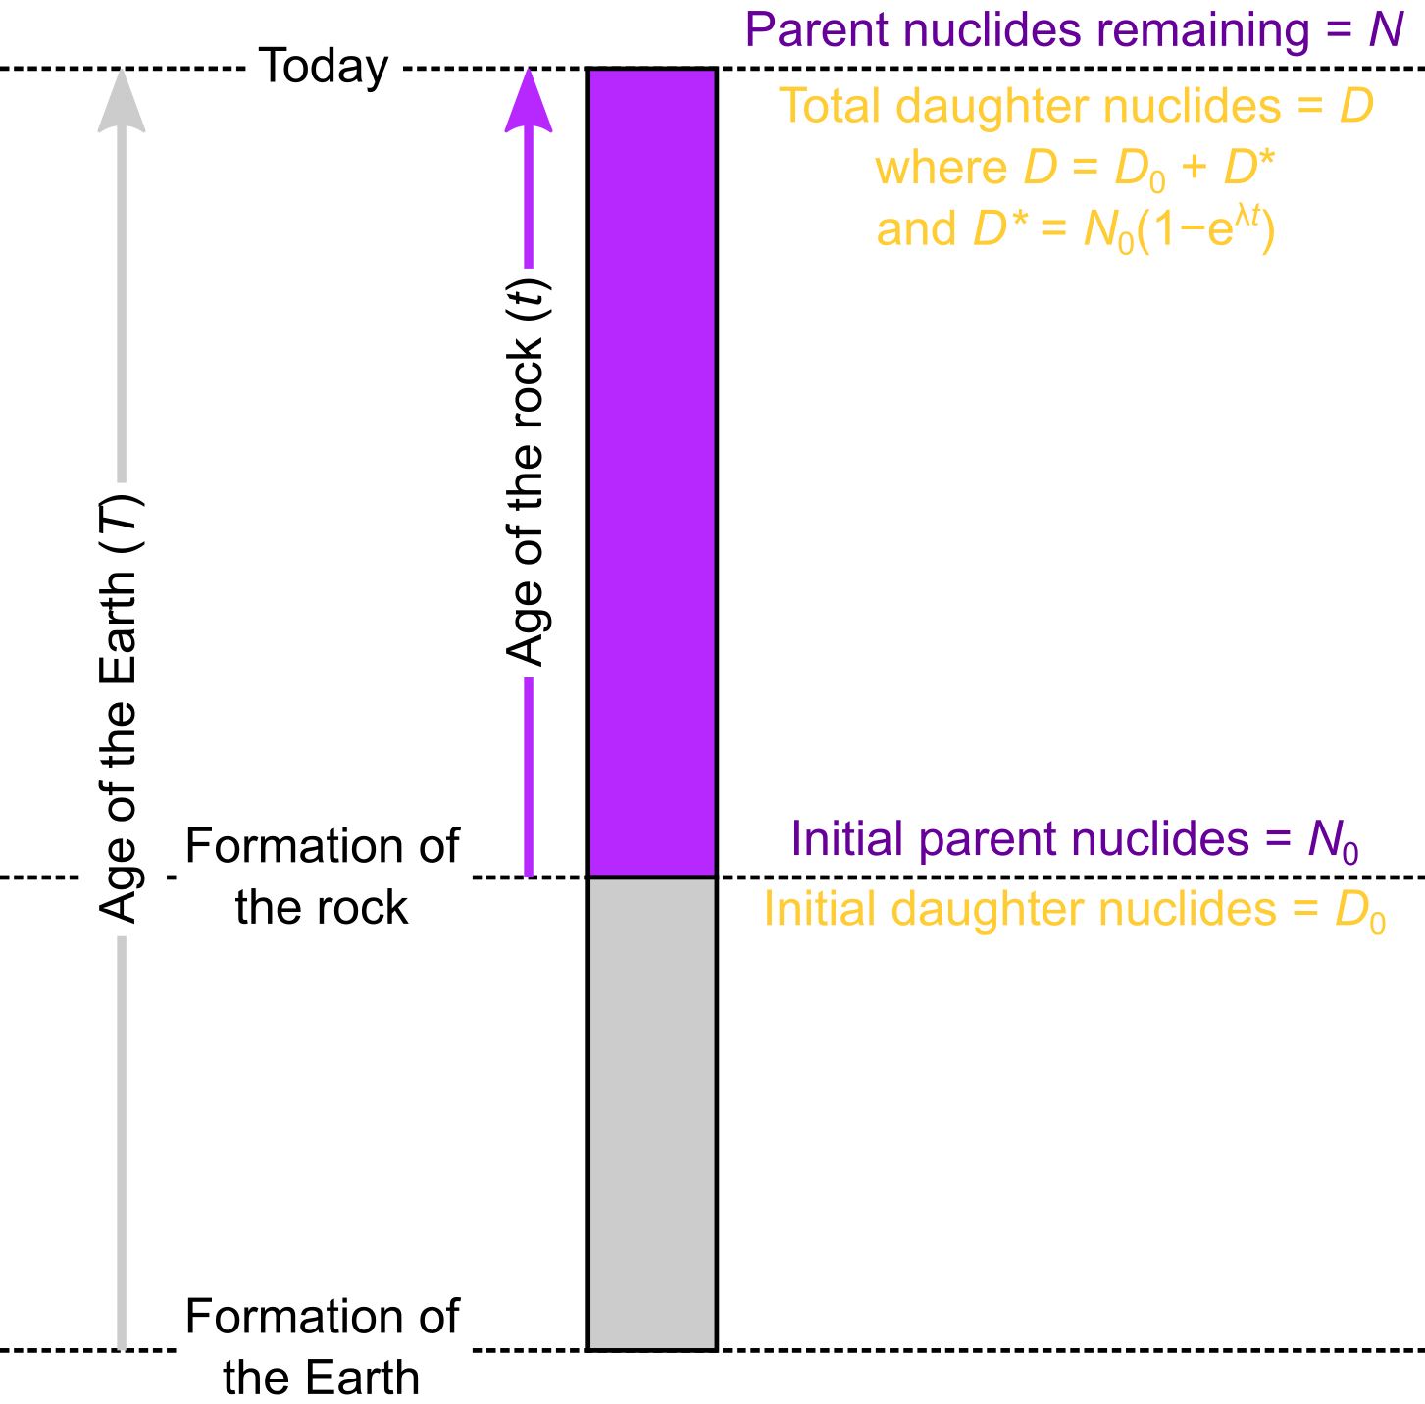
Radioactive decay in a geological context
Most geochemical events (like melting or crystallisation) occurred at some time ($t$) less than the age of the Earth ($T$)
Some amount of both parent and daughter nuclides will already be present ($N0$ and $D0$)
After $t$, the total number of daughter nuclides ($D$) will be the sum of $D0$ and those produced by decay from $N0$ over $t$ ($D^{∗}$)

Slide 14
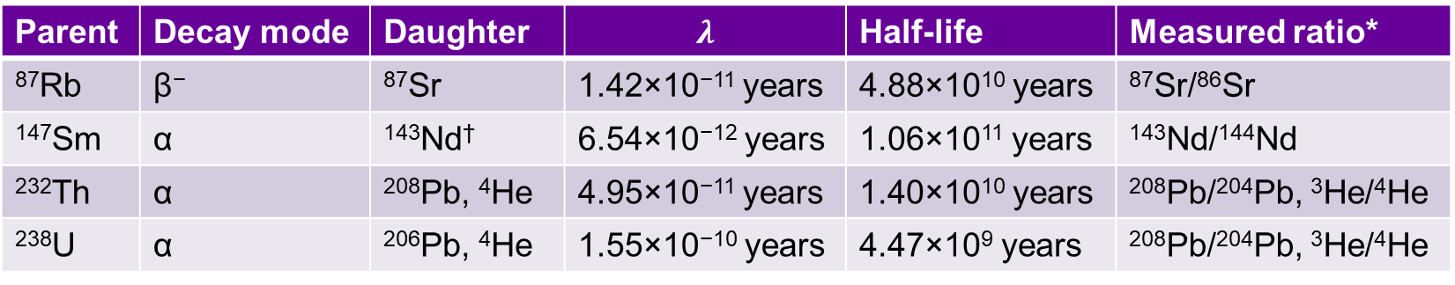
Key decay systems of geochemical interest
Many geochemically important systems have very long half-lives:
  *Radiogenic isotopes are measured with respect to non-radiogenic isotopes
  † Very little ⁴He is produced by ¹⁴⁷Sm decay when compared with ²³²Th or ²³⁸U decay
Parent | Decay mode | Daughter | $$λ$$ | Half-life | Measured ratio*
⁸⁷Rb | β⁻ | ⁸⁷Sr | 1.42×10⁻¹¹ years | 4.88×10¹⁰ years | ⁸⁷Sr/⁸⁶Sr
¹⁴⁷Sm | α | ¹⁴³Nd† | 6.54×10⁻¹² years | 1.06×10¹¹ years | ¹⁴³Nd/¹⁴⁴Nd
²³²Th | α | ²⁰⁸Pb, ⁴He | 4.95×10⁻¹¹ years | 1.40×10¹⁰ years | ²⁰⁸Pb/²⁰⁴Pb, ³He/⁴He
²³⁸U | α | ²⁰⁶Pb, ⁴He | 1.55×10⁻¹⁰ years | 4.47×10⁹ years | ²⁰⁸Pb/²⁰⁴Pb, ³He/⁴He

Slide 15
The age and provenance of rocks: radiogenic isotopes
EART26201 | Principles of Geochemistry | Lecture 2
Part 3 | Dating and isochron diagrams

Slide 16
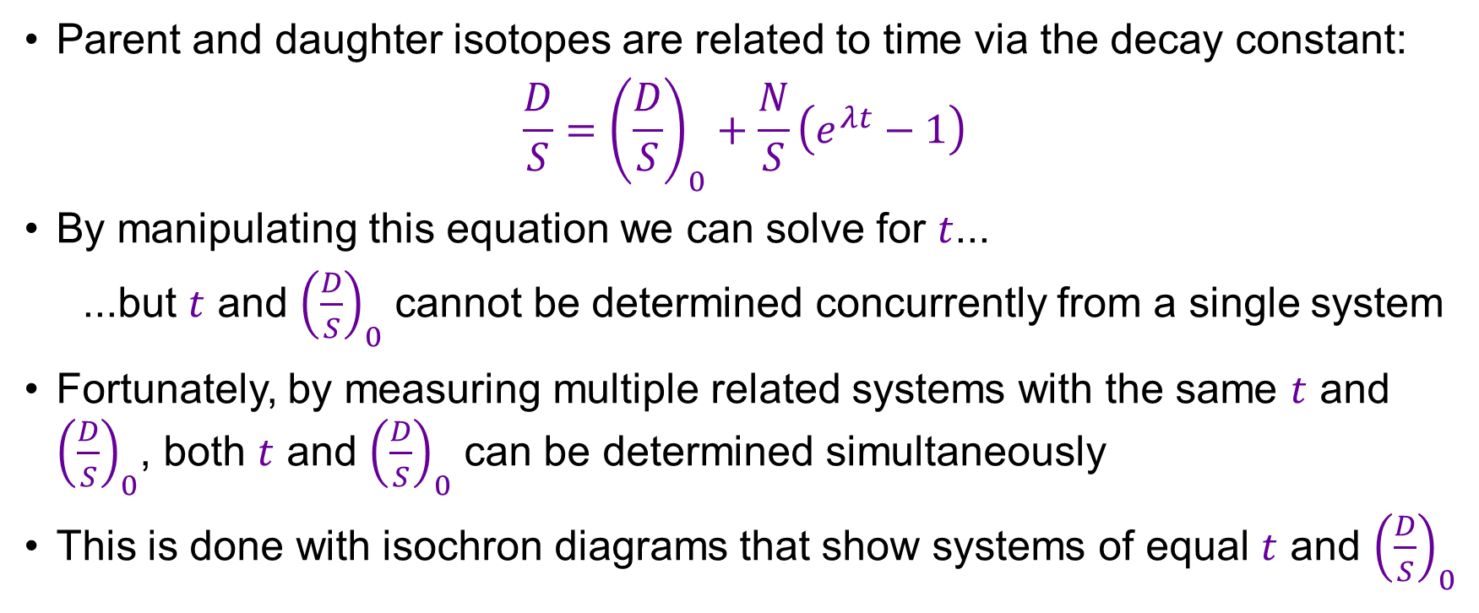
Geochronology
Parent and daughter isotopes are related to time via the decay constant:
$$\frac{D}{S}={\left(\frac{D}{S}\right)}_{0}+\frac{N}{S}\left(e^{λt}−1\right)$$
By manipulating this equation we can solve for $t$...
...but $t$ and ${\left(\frac{D}{S}\right)}_{0}$ cannot be determined concurrently from a single system
Fortunately, by measuring multiple related systems with the same $t$ and ${\left(\frac{D}{S}\right)}_{0}$, both $t$ and ${\left(\frac{D}{S}\right)}_{0}$ can be determined simultaneously
This is done with isochron diagrams that show systems of equal $t$ and ${\left(\frac{D}{S}\right)}_{0}$

Slide 17
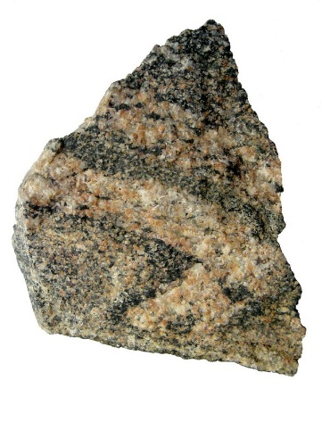
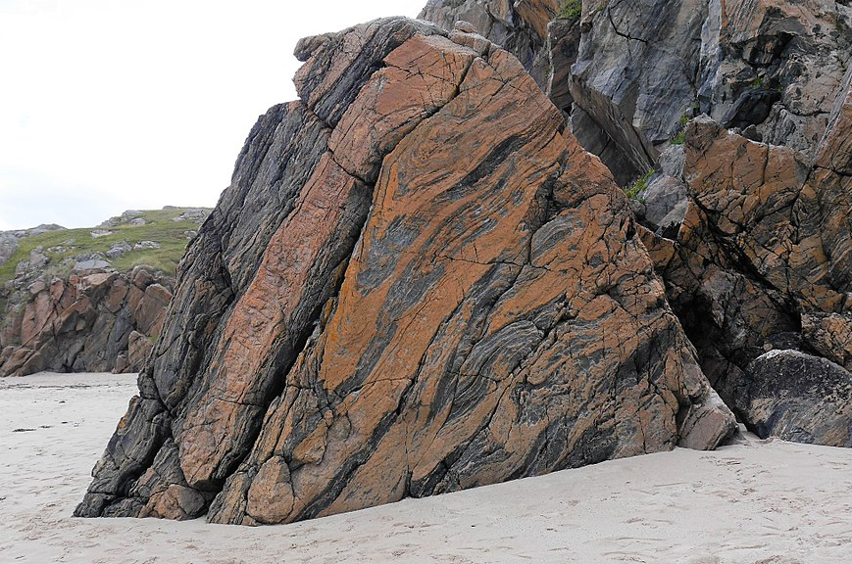
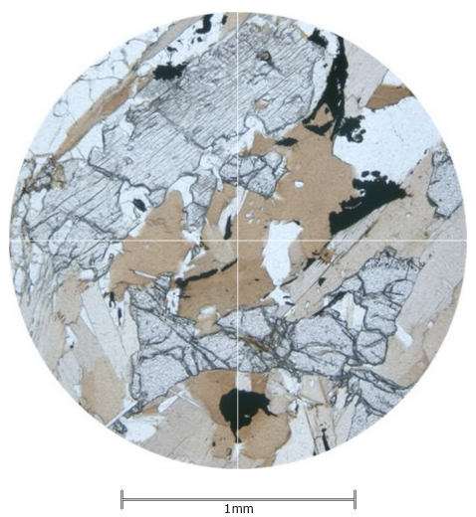

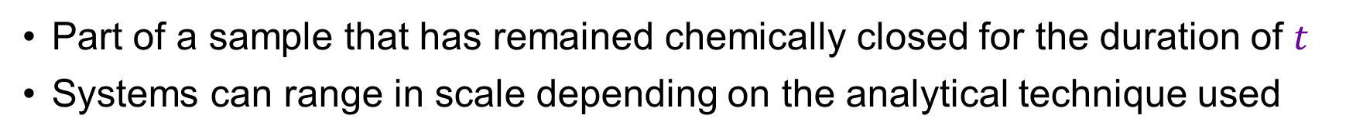
What is a system?
can be divided into...
can be divided into...
An outcrop
whole-rock samples
individual mineral grains
credit: Daniel Burgess
credit: Kevin Walsh
www.virtualmicroscope.org
Part of a sample that has remained chemically closed for the duration of $t$
Systems can range in scale depending on the analytical technique used

Slide 18
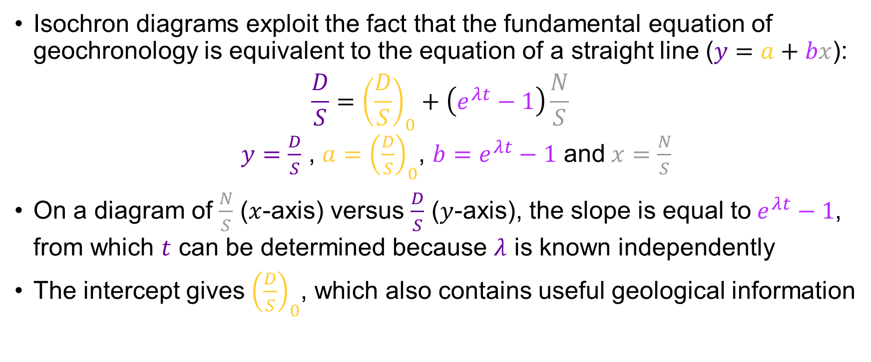
Isochron diagrams
Isochron diagrams exploit the fact that the fundamental equation of geochronology is equivalent to the equation of a straight line ($y=a+bx$):
$$\frac{D}{S}={\left(\frac{D}{S}\right)}_{0}+\left(e^{λt}−1\right)\frac{N}{S}$$
  $y=\frac{D}{S}$ , ${a=\left(\frac{D}{S}\right)}_{0}$, $b=e^{λt}−1$ and$x=\frac{N}{S}$
On a diagram of $\frac{N}{S}$ ($x$-axis) versus $\frac{D}{S}$ ($y$-axis), the slope is equal to$e^{λt}−1$, from which $t$ can be determined because $λ$ is known independently
The intercept gives ${\left(\frac{D}{S}\right)}_{0}$, which also contains useful geological information

Slide 19
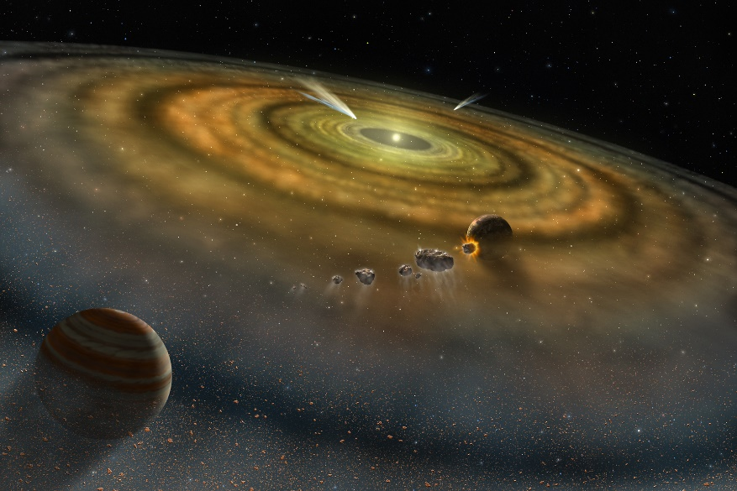
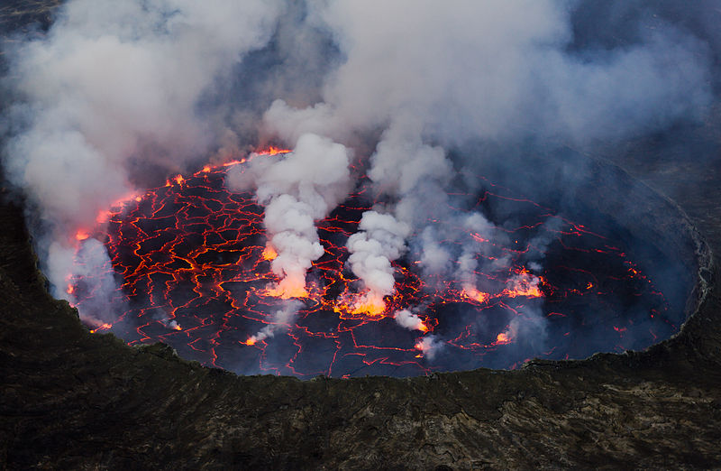
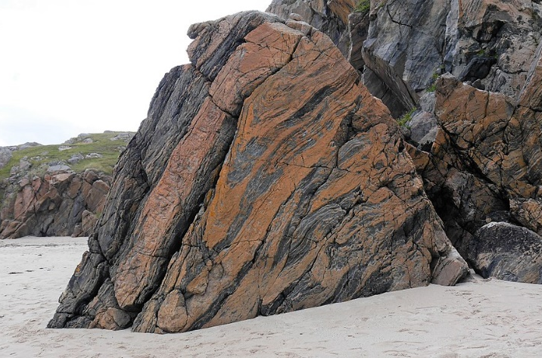


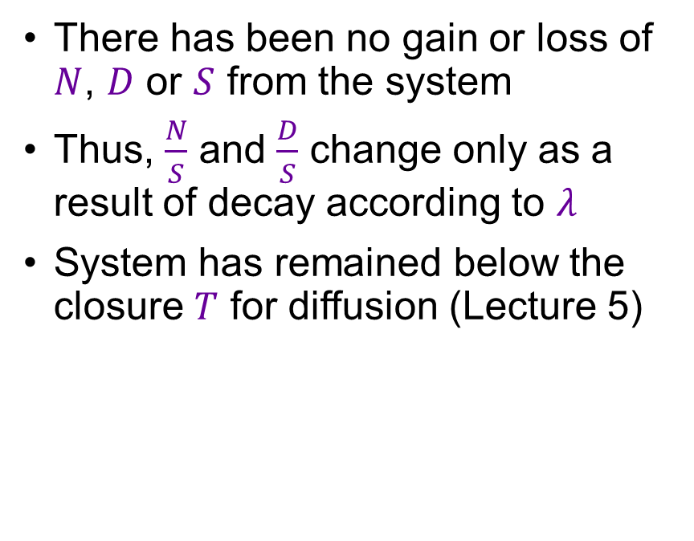
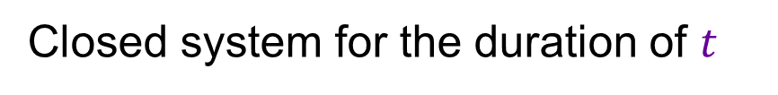
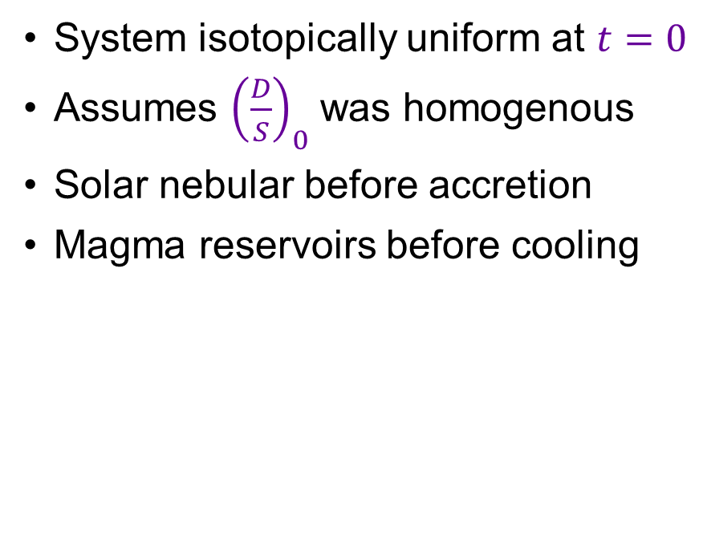
Isochron diagram assumptions
Isotopic equilibrium at$t=0$
Closed system for the duration of $t$
System isotopically uniform at $t=0$
Assumes ${\left(\frac{D}{S}\right)}_{0}$ was homogenous
Solar nebular before accretion
Magma reservoirs before cooling
There has been no gain or loss of $N$, $D$ or $S$ from the system
Thus, $\frac{N}{S}$ and $\frac{D}{S}$ change only as a result of decay according to $λ$
System has remained below the closure $T$ for diffusion (Lecture 5)

Slide 20
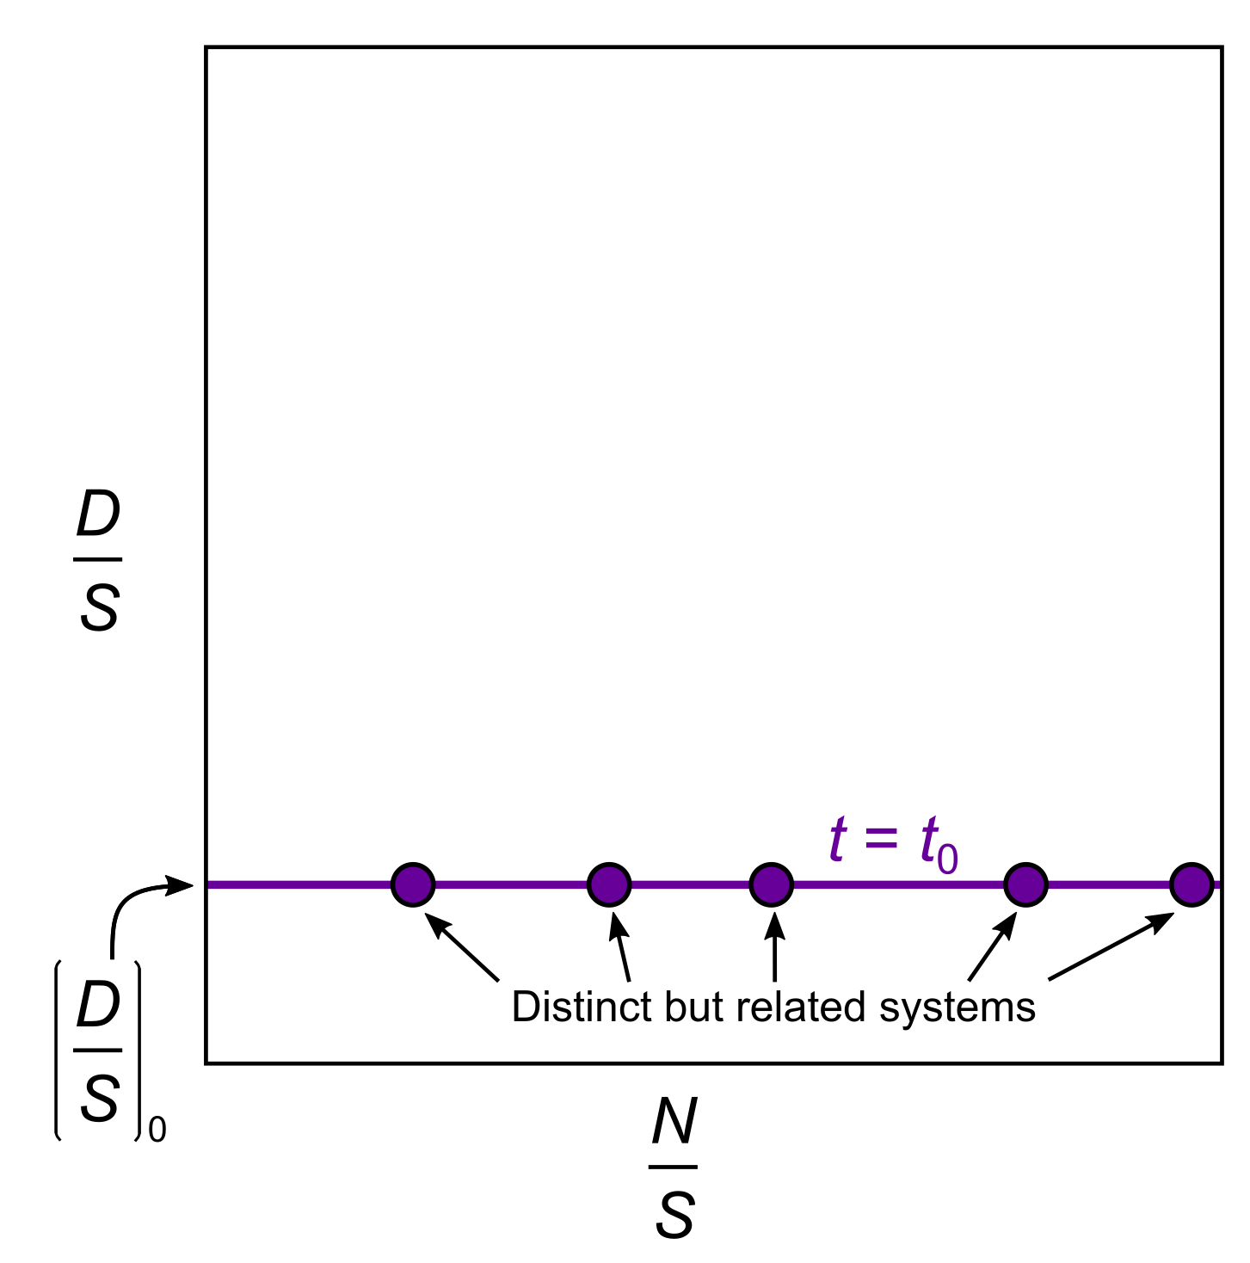
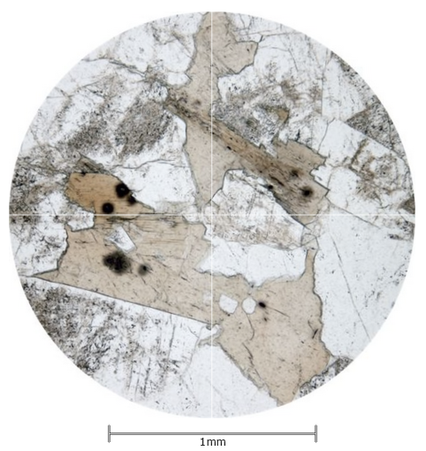
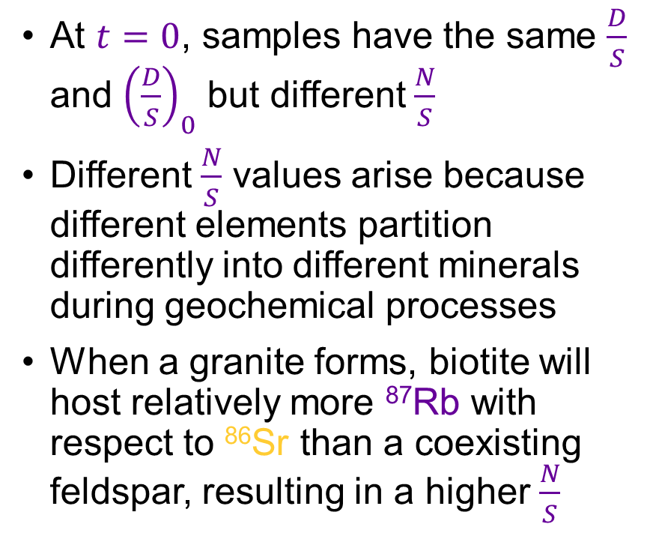
Constructing and interpreting isochron diagrams
At $t=0$, samples have the same $\frac{D}{S}$ and ${\left(\frac{D}{S}\right)}_{0}$ but different $\frac{N}{S}$
Different $\frac{N}{S}$ values arise because different elements partition differently into different minerals during geochemical processes
When a granite forms, biotite will host relatively more ⁸⁷Rb with respect to ⁸⁶Sr than a coexisting feldspar, resulting in a higher $\frac{N}{S}$
Partition coefficients are discussed in Lecture 1
Biotite has high ⁸⁷Rb/⁸⁶Sr:
D_{Rb}/D_{Sr} is high
Feldspar has low ⁸⁷Rb/⁸⁶Sr:
D_{Rb}/D_{Sr} is low
www.virtualmicroscope.org

Slide 21
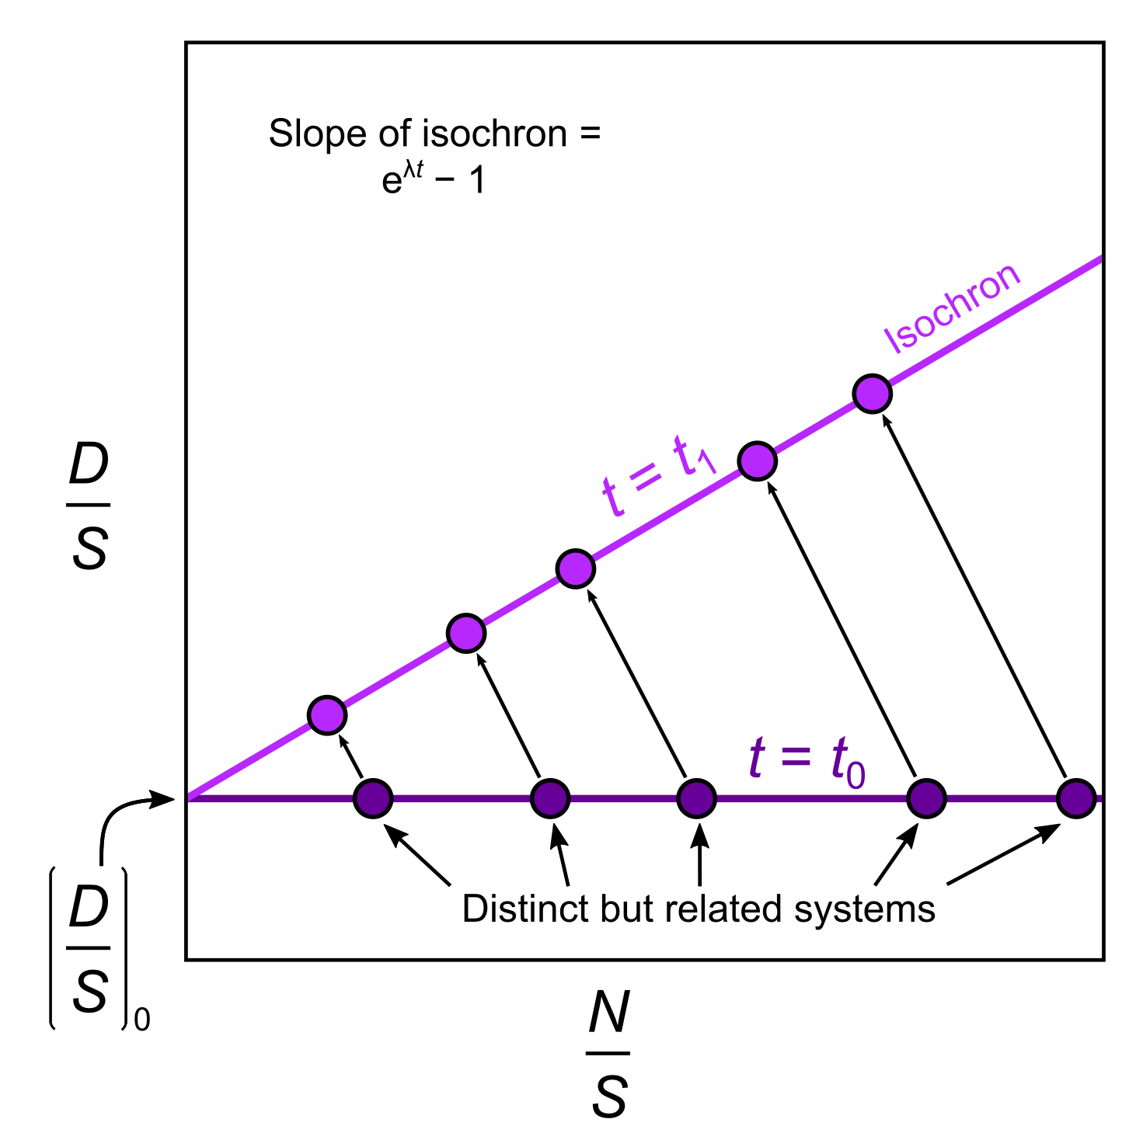
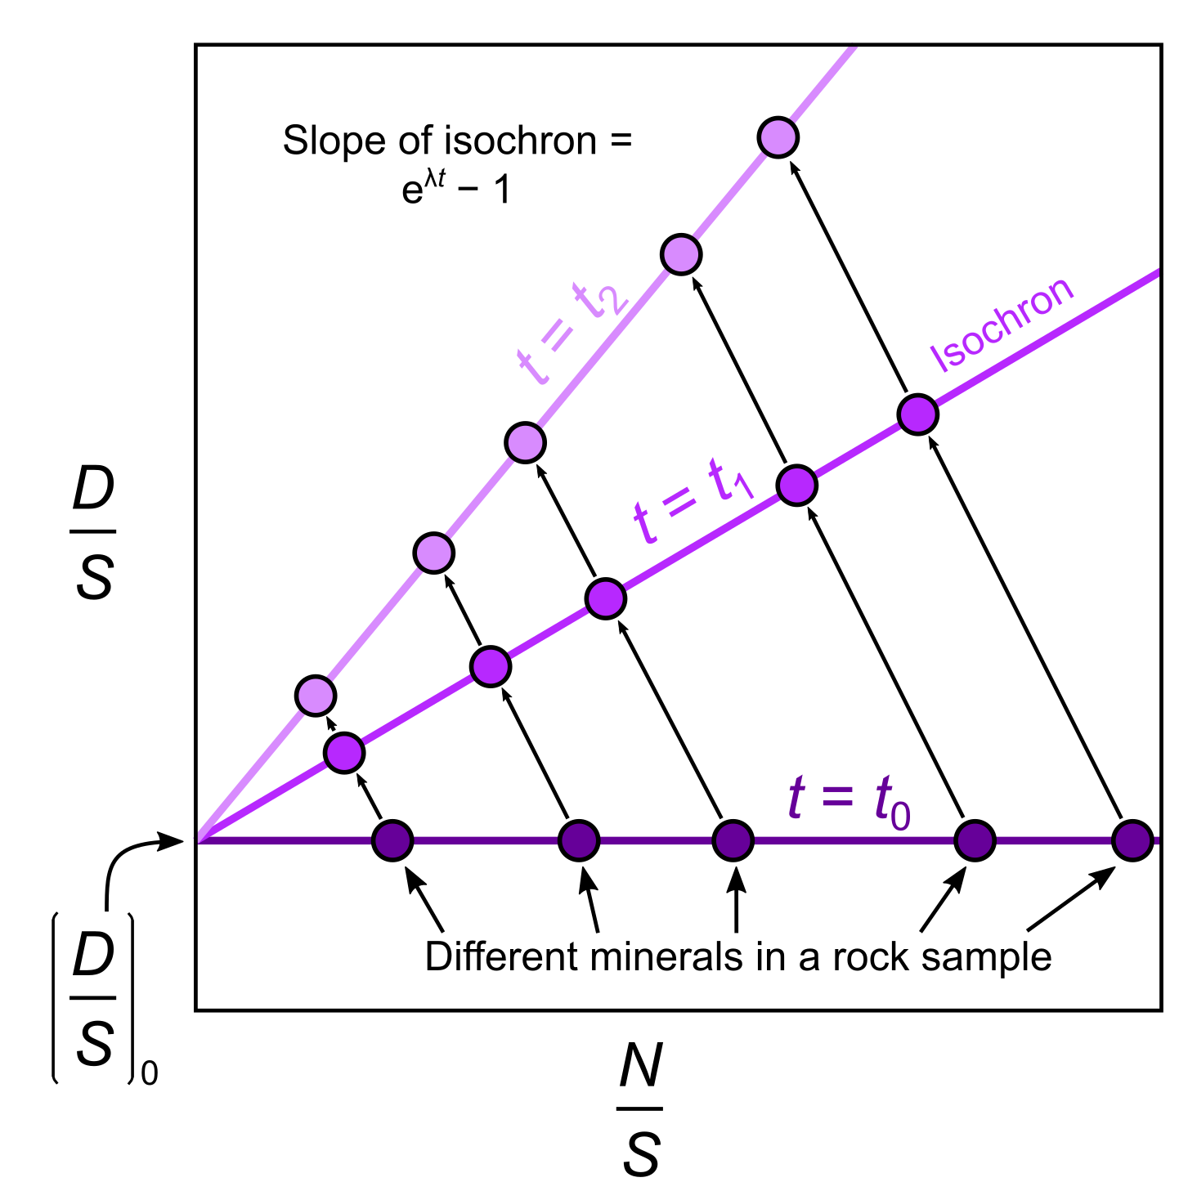
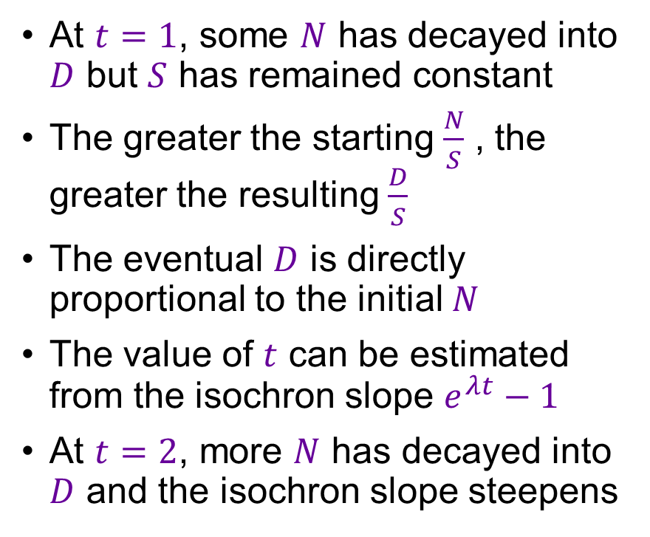
Constructing and interpreting isochron diagrams
At $t=1$, some $N$ has decayed into $D$ but $S$ has remained constant
The greater the starting $\frac{N}{S}$ , the greater the resulting $\frac{D}{S}$
The eventual $D$ is directly proportional to the initial $N$
The value of $t$ can be estimated from the isochron slope $e^{λt}−1$
At $t=2$, more $N$ has decayed into $D$ and the isochron slope steepens

Slide 22
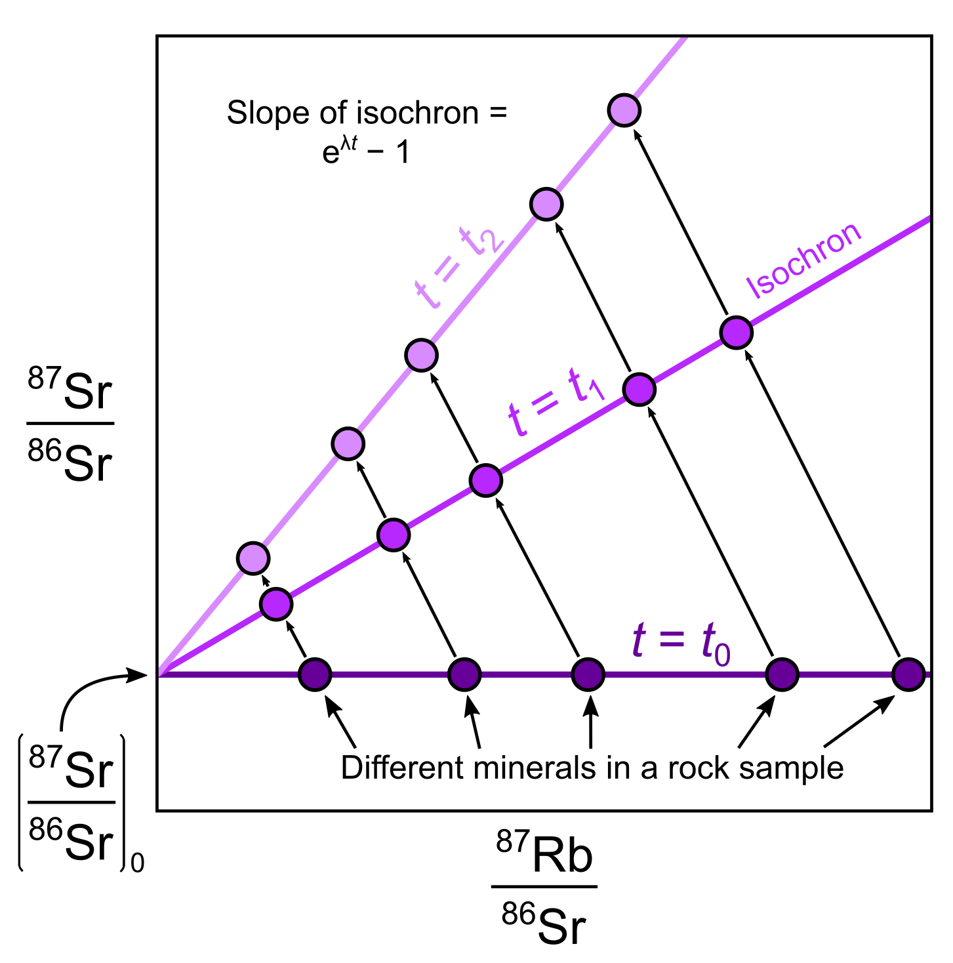
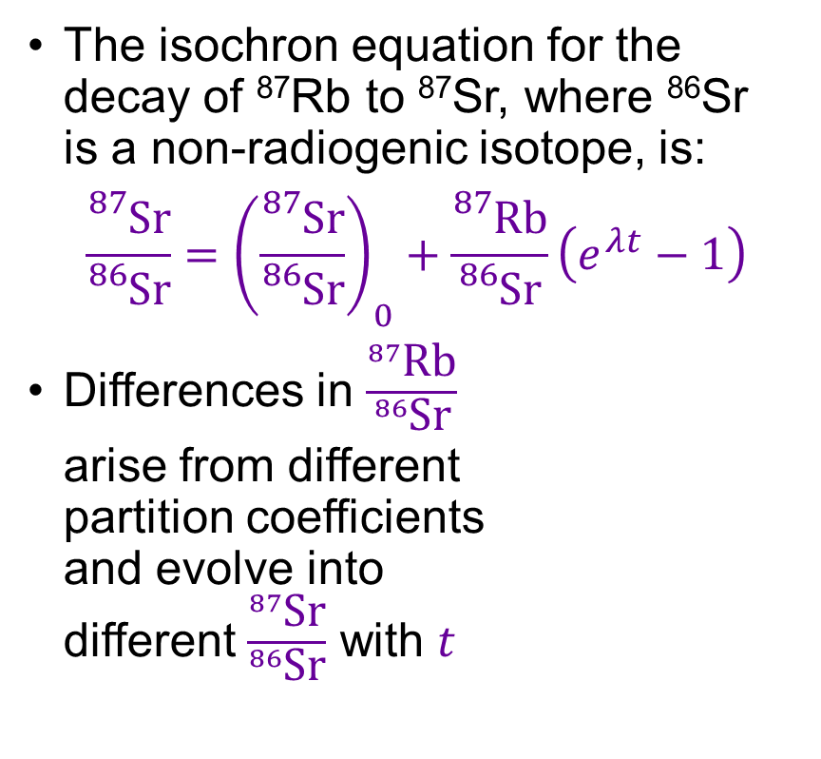
Generic isochron diagram for Rb-Sr system
The isochron equation for the decay of ⁸⁷Rb to ⁸⁷Sr, where ⁸⁶Sr
is a non-radiogenic isotope, is:
$$\frac{{}_{}^{87}{\text{Sr}}}{{}_{}^{86}{\text{Sr}}}={\left(\frac{{}_{}^{87}{\text{Sr}}}{{}_{}^{86}{\text{Sr}}}\right)}_{0}+\frac{{}_{}^{87}{\text{Rb}}}{{}_{}^{86}{\text{Sr}}}\left(e^{λt}−1\right)$$
Differences in $\frac{{}_{}^{87}{\text{Rb}}}{{}_{}^{86}{\text{Sr}}}$
arise from different
partition coefficients
and evolve into
different $\frac{{}_{}^{87}{\text{Sr}}}{{}_{}^{86}{\text{Sr}}}$ with $t$

Slide 23
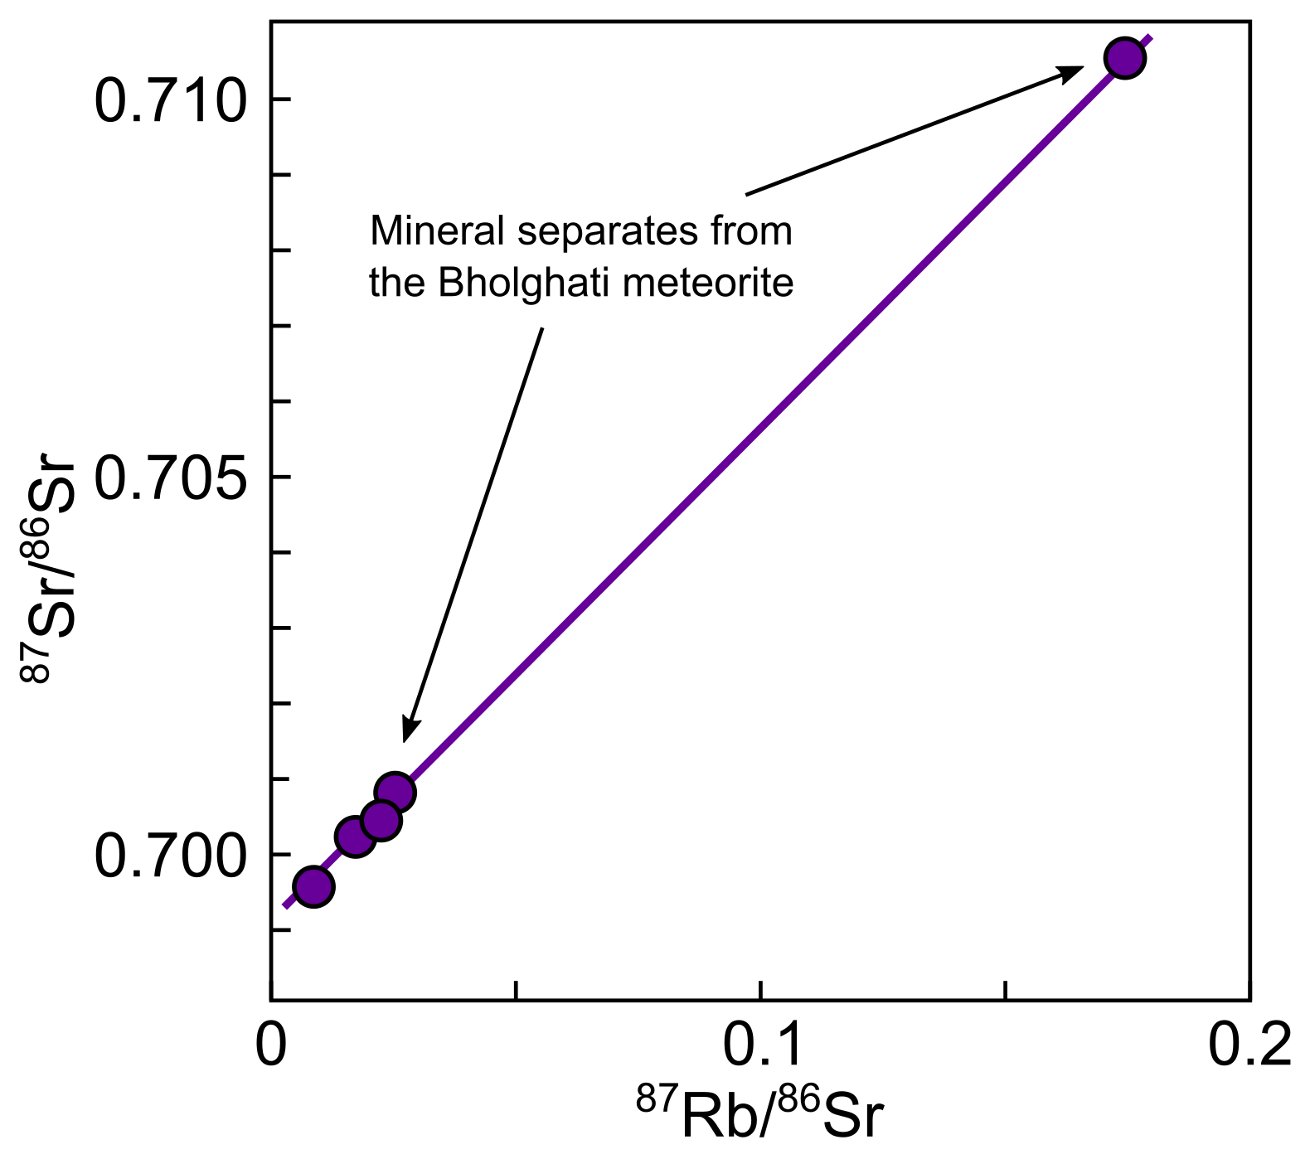
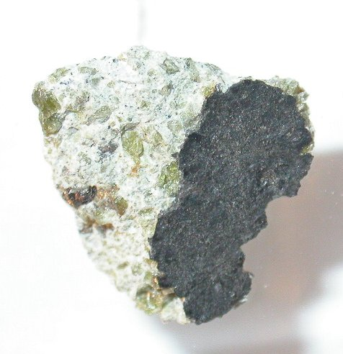
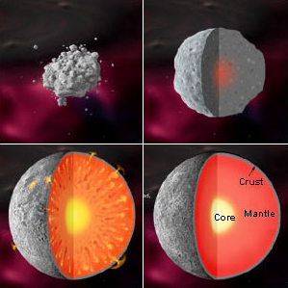
Dating the formation of early planetesimal crusts
Analyses of mineral separates from the Bholghati meteorite define an isochron in the Rb-Sr system
Bholghati is a stony achondrite meteorite, and its age
of ~4.57 Ga likely
records the growth
of an early crust
credit: Don Edwards

Slide 24
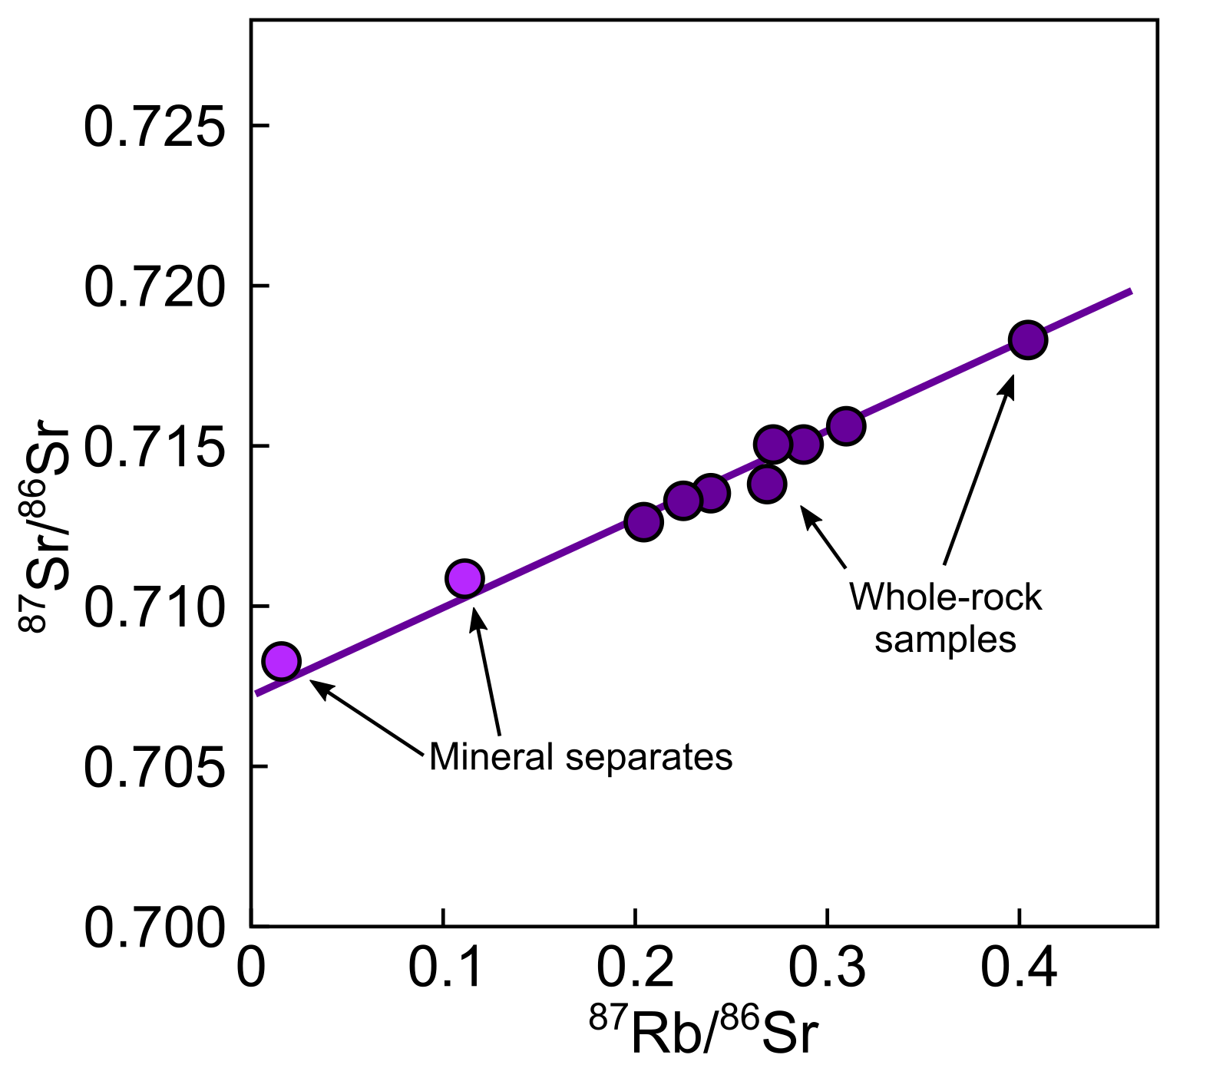
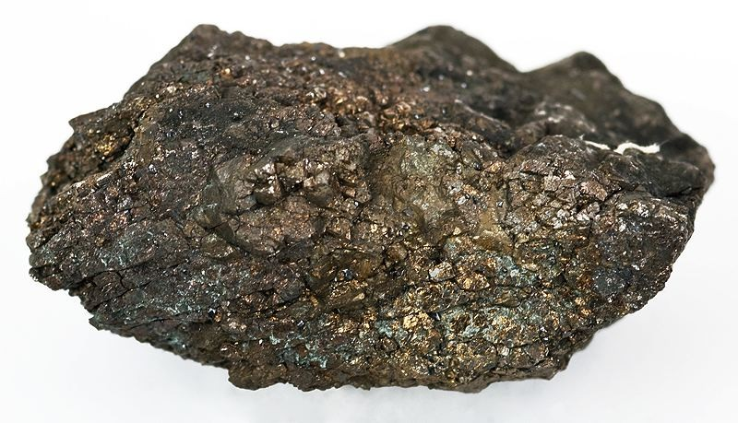
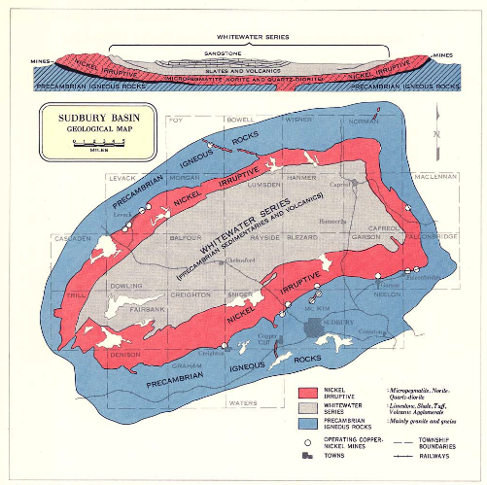
Dating the formation of impacts and ore deposits
The Sudbury Nickel Irruptive is a large Ni deposit that formed after a bolide (meteor/comet) impact instantaneously melted a large volume of crust in Ontario, Canada
Analyses of mineral separates and whole-rock samples define an isochron with an age of ~1.8 Ga

Slide 25
The age and provenance of rocks: radiogenic isotopes
EART26201 | Principles of Geochemistry | Lecture 2
Part 4 | Isotopic evolution of the crust and mantle

Slide 26
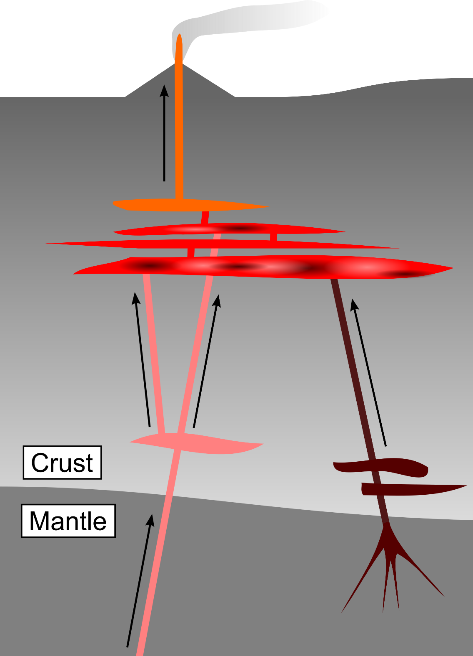
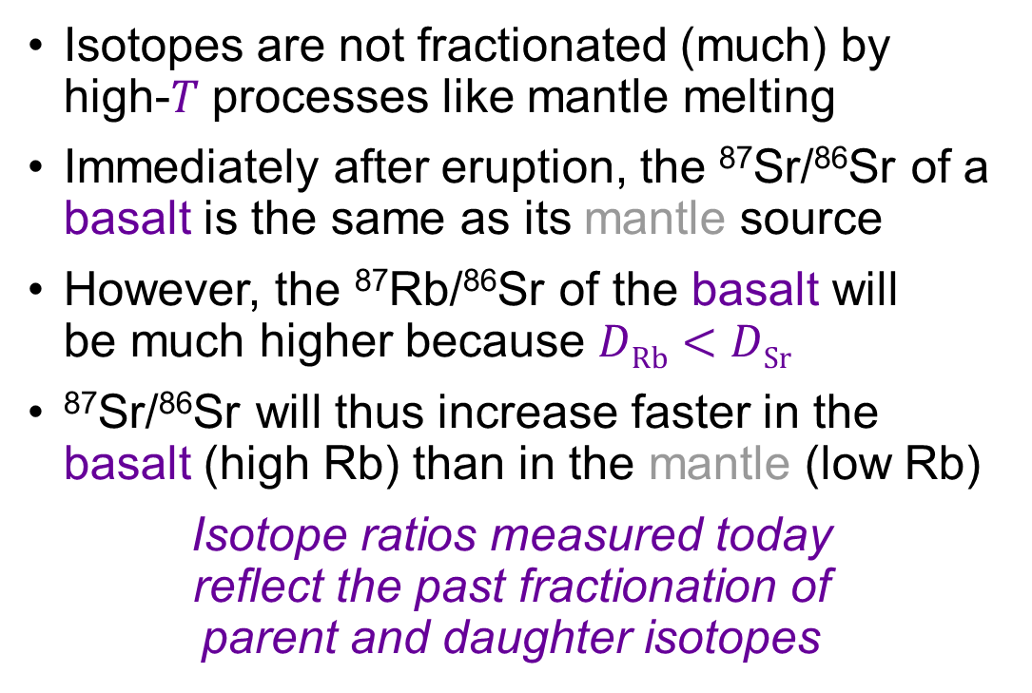
Radiogenic isotopes record past geochemical events
Isotopes are not fractionated (much) by high-$T$ processes like mantle melting
Immediately after eruption, the ⁸⁷Sr/⁸⁶Sr of a basalt is the same as its mantle source
However, the ⁸⁷Rb/⁸⁶Sr of the basalt will
be much higher because $D\text{Rb}<D\text{Sr}$
⁸⁷Sr/⁸⁶Sr will thus increase faster in the basalt (high Rb) than in the mantle (low Rb)
Isotope ratios measured today
reflect the past fractionation of
parent and daughter isotopes
Lecture 1

Slide 27
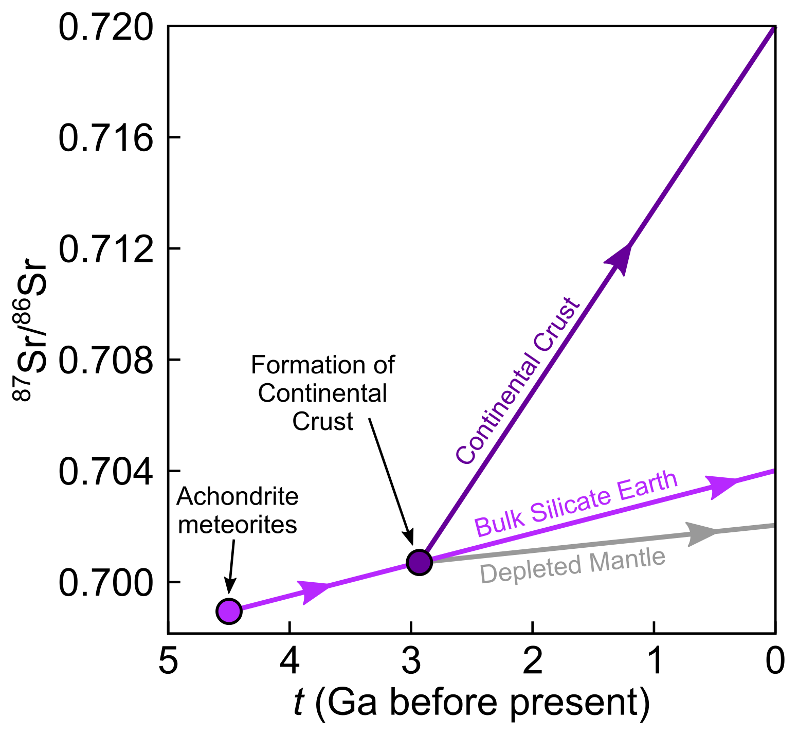
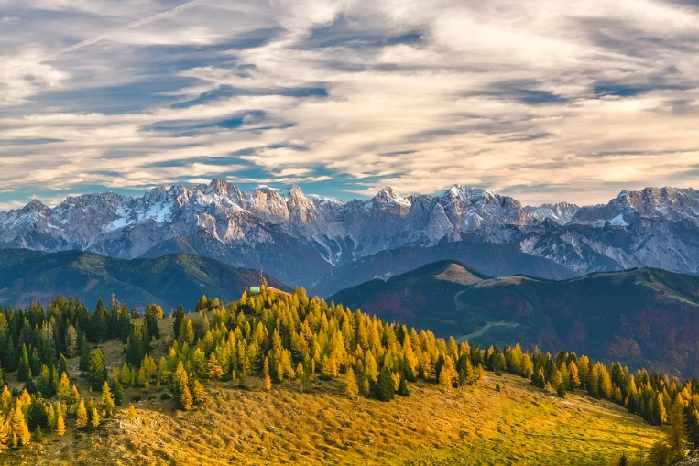
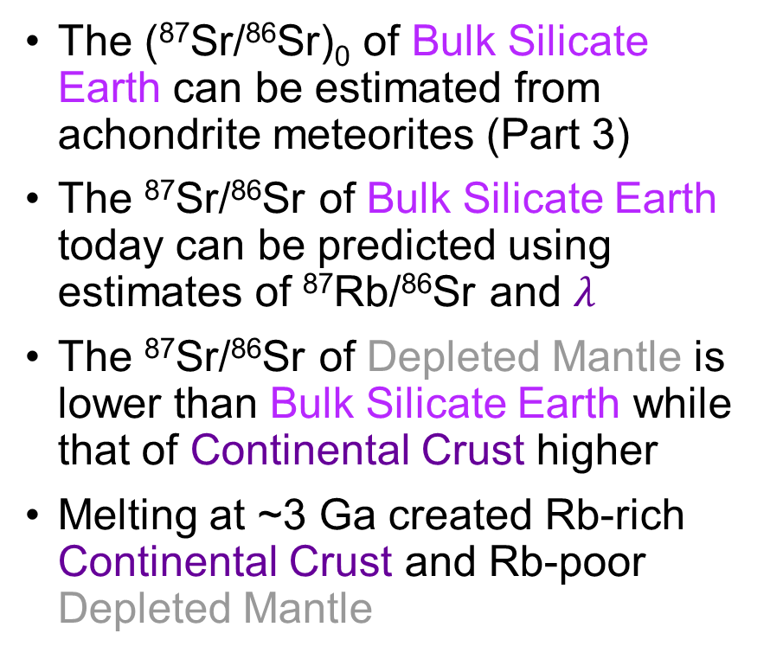
The Sr isotope evolution of the crust and mantle
The (⁸⁷Sr/⁸⁶Sr)₀ of Bulk Silicate Earth can be estimated from achondrite meteorites (Part 3)
The ⁸⁷Sr/⁸⁶Sr of Bulk Silicate Earth today can be predicted using estimates of ⁸⁷Rb/⁸⁶Sr and $λ$
The ⁸⁷Sr/⁸⁶Sr of Depleted Mantle is lower than Bulk Silicate Earth while that of Continental Crust higher
Melting at ~3 Ga created Rb-rich Continental Crust and Rb-poor Depleted Mantle
Trace elements tell the same story (Lecture 1)

Slide 28
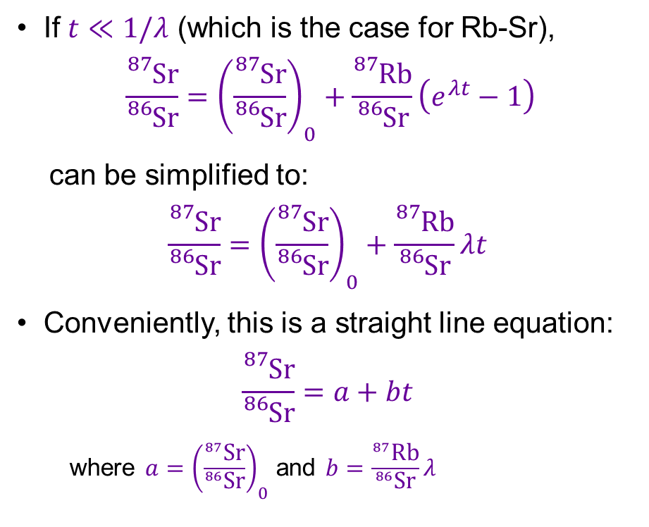
How the Sr isotope evolution diagram works
If $t≪1/λ$ (which is the case for Rb-Sr),
$$\frac{{}_{}^{87}{\text{Sr}}}{{}_{}^{86}{\text{Sr}}}={\left(\frac{{}_{}^{87}{\text{Sr}}}{{}_{}^{86}{\text{Sr}}}\right)}_{0}+\frac{{}_{}^{87}{\text{Rb}}}{{}_{}^{86}{\text{Sr}}}\left(e^{λt}−1\right)$$
can be simplified to:
$$\frac{{}_{}^{87}{\text{Sr}}}{{}_{}^{86}{\text{Sr}}}={\left(\frac{{}_{}^{87}{\text{Sr}}}{{}_{}^{86}{\text{Sr}}}\right)}_{0}+\frac{{}_{}^{87}{\text{Rb}}}{{}_{}^{86}{\text{Sr}}}λt$$
Conveniently, this is a straight line equation:
$$\frac{{}_{}^{87}{\text{Sr}}}{{}_{}^{86}{\text{Sr}}}=a+bt$$
  where $a={\left(\frac{{}_{}^{87}{\text{Sr}}}{{}_{}^{86}{\text{Sr}}}\right)}_{0}$ and $b=\frac{{}_{}^{87}{\text{Rb}}}{{}_{}^{86}{\text{Sr}}}λ$

Slide 29
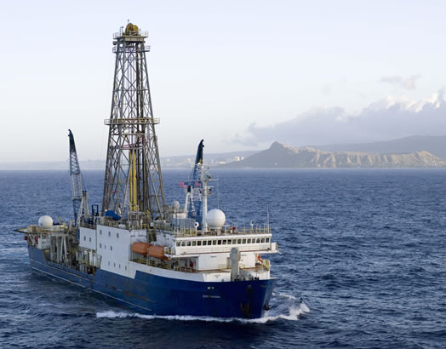
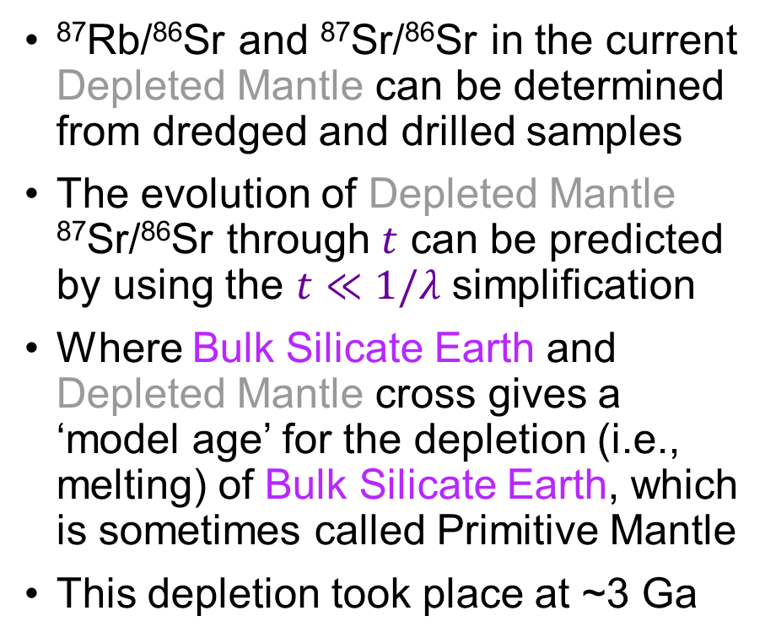
What the Sr isotope evolution diagram shows
⁸⁷Rb/⁸⁶Sr and ⁸⁷Sr/⁸⁶Sr in the current Depleted Mantle can be determined from dredged and drilled samples
The evolution of Depleted Mantle ⁸⁷Sr/⁸⁶Sr through $t$ can be predicted by using the $t≪1/λ$ simplification
Where Bulk Silicate Earth and Depleted Mantle cross gives a ‘model age’ for the depletion (i.e., melting) of Bulk Silicate Earth, which is sometimes called Primitive Mantle
This depletion took place at ~3 Ga
credit: IODP

Slide 30

What the Sr isotope evolution diagram shows
⁸⁷Rb/⁸⁶Sr and ⁸⁷Sr/⁸⁶Sr in the current Continental Crust can be estimated from exposed metamorphic rocks and the sedimentary products of erosion
Where Bulk Silicate Earth and Continental Crust cross gives a
‘model age’ for continent formation...
...from melts produced by melting BSE to create the Depleted Mantle
But, reality is much more complex...
Mantle melting and continent formation
processes are continuous

Slide 31
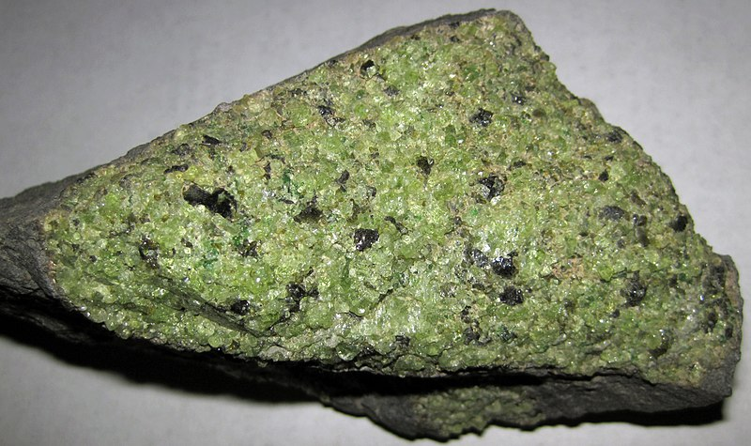


Rb-Sr versus Sm-Nd systems
Rb and Sr are highly mobile during weathering and alteration
Sr isotope measurements may not reliably record high-$T$ processes
Sm and Nd (REEs) are relatively immobile when compared with Rb and Sr (Rb is a LILE)
¹⁴³Nd/¹⁴⁴Nd can thus be more reliable than ⁸⁷Sr/⁸⁶Sr
Rb-Sr and Sm-Nd systems are often studied together (Part 5)
credit: James St. John
Mantle
xenolith
Weathered
serpentinite
credit: Pierre Terre

Slide 32

The Nd isotope evolution of the crust and mantle
Analogous to Sr isotope evolution of the crust and mantle except...
(¹⁴³Nd/¹⁴⁴Nd)₀ is estimated from chondrites because Sm and Nd are refractory (unlike volatile Rb)
The parent isotope (¹⁴⁷Sm) is more compatible than the daughter isotope (¹⁴³Nd) – opposite of Rb-Sr
Thus, Depleted Mantle evolves to high ¹⁴³Nd/¹⁴⁴Nd while Continental Crust evolves to low ¹⁴³Nd/¹⁴⁴Nd

Slide 33
The age and provenance of rocks: radiogenic isotopes
EART26201 | Principles of Geochemistry | Lecture 2
Part 5 | Provenance and the mantle array

Slide 34


Passive tracers
A passive tracer tracks the flow of a fluid without either reacting with it or affecting its movement
Pigment in ink is a passive tracer
When dropped into clear water, the pigment shows how the drop of ink moves and mixes with the water
Isotope ratios act as passive tracers in geochemical systems:
  unaffected by ongoing reactions
  only modified by $t$ and mixing

Slide 35


Sr isotopes as passive tracers
Sr isotope compositions provide information about magma sources
Magmas created by melting the Depleted Mantle have low ⁸⁷Sr/⁸⁶Sr
Magmas created by melting the Continental Crust have high ⁸⁷Sr/⁸⁶Sr
credit: NOAA
credit: Gabriel Esteffan

Slide 36

The mantle array: summarising Sr and Nd isotopes
Negative correlation between Sr and Nd isotopes for most basalts
Mid-ocean ridge basalts are sourced from the Depleted Mantle
Ocean island basalts sourced from mantle plumes are often similar to Bulk Silicate Earth (recycling)
Continental basalts are from the mantle but are contaminated by melts from the Continental Crust

Slide 37


Subduction recycling and ocean island basalts
Subducted lithosphere is recycled into the convecting mantle
This recycling re-enriches the Depleted Mantle creating compositions like Bulk Silicate Earth that melt under hotspots
Koppers et al. (2021)
Recycled crust?
There are still many uncertainties
Primitive mantle?
(Bulk Silicate Earth)

Slide 38



Crustal contamination in the Tertiary North Atlantic
Emeleus & Bell (2005)
The opening of the North Atlantic at ~60 Ma was associated with extensive magmatism and volcanism
Basalts from the proto-Iceland plume erupted through Continental Crust

Slide 39


Different styles of contamination in different places
The most depleted lavas from the Scottish Tertiary are broadly similar to mid-ocean ridge basalts, but...
Lavas from Skye trend to low ¹⁴³Nd/¹⁴⁴Nd and low ⁸⁷Sr/⁸⁶Sr, consistent with contamination from the Lower Continental Crust
Igneous rocks from Rum have low ¹⁴³Nd/¹⁴⁴Nd but high ⁸⁷Sr/⁸⁶Sr consistent with contamination from the Upper Continental Crust
Different magma plumbing systems?

Slide 40


Tracking changes in mantle source beneath Hawaii
Compositions of lavas erupted on Hawaiian islands change with time
Lavas erupted early and late in a volcano’s lifecycle (Alkalic Pre- and Post-Shield) are relatively depleted
Lavas from the main phase of volcano growth (Tholeiitic Shield) are more enriched and closer to Bulk Silicate Earth (mantle plume)
credit: Nula666

Slide 41

Magmas compositions controlled by plate tectonics
Compositions mainly reflect the movement of the Pacific Plate over the underlying mantle plume
The mantle is also heterogeneous

